Slide 1
Using Ohio Teacher Evaluation Data to Inform Professional Learning
Notes:
All of these materials may be used and adapted to fit the needs of the state or local context. If modifications are made to content, please use the following statement: These materials have been adapted in whole or in part with permission from the Center on Great Teachers and Leaders.

Slide 2
Welcome, Introductions, and Agenda

Slide 3

Welcome!

Slide 4
Mission of the Center on
Great Teachers and Leaders
The mission of the Center on Great Teachers and Leaders (GTL Center) is to foster the capacity of vibrant networks of practitioners, researchers, innovators, and experts to build and sustain a seamless system of support for great teachers and leaders for every school in every state in the nation.

Slide 5
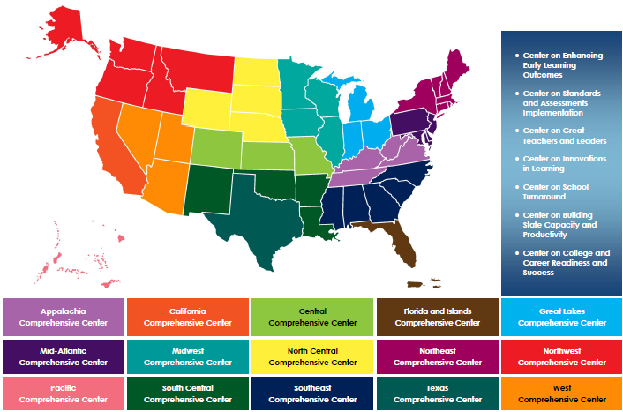
Comprehensive Centers Program
2012–2017 Award Cycle

Slide 6
Agenda
Module Purpose and Overview
Definitions and Assumptions
Using Evaluation Data for Self-Assessment and
Goal Setting
Using Evaluation Data for Formative Feedback
Using Final Summative Evaluation Data for Individual and Schoolwide Planning
Understanding Systemic Supports for Effective Use of Evaluation Data to Inform Professional Learning
Reflection and Wrap-Up

Slide 7
Module Purpose and Overview

Slide 8
Module Overview
Goals:
  Explain how teacher evaluation data informs professional learning.
  Practice analyzing teacher evaluation data to inform professional learning.
  Discuss the challenges and opportunities for using evaluation data to inform professional learning.

Slide 9
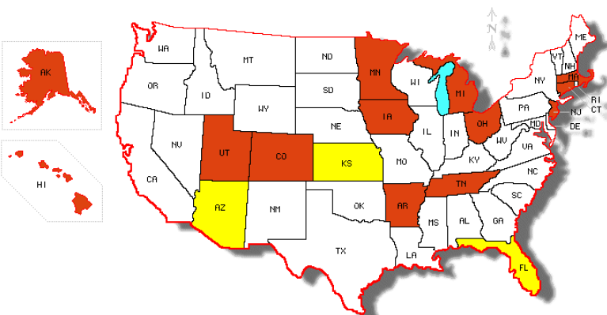
National Picture
Professional Growth in Educator Evaluations: Defined by Regulations
= Professional Growth or Learning
= Improvement Only

Slide 10
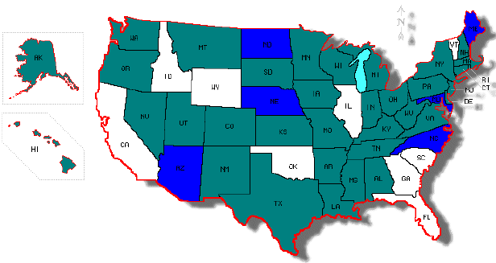
National Picture: A Different View
Professional Growth in Educator Evaluations: Defined by State Guidance or
Elementary and Secondary Education Act Waiver Applications
= Professional Growth or Learning
= Improvement Only

Slide 11
Definitions and Assumptions

Slide 12
Activity 1: Human Continuum
One side of the room is designated “Strongly Agree,”
and the other side of the room is designated
“Strongly Disagree.”
As the statement is read, determine where your district falls on the continuum. Vote with your feet.
Turn to someone next to you. Share your rationale for why you chose this place on the continuum.

Slide 13

Activity 2: Table Warm-Up
As a group, brainstorm a list of types of professional learning (activities, designs, venues, modes of delivery) currently used in your state.
Write these types on the chart paper provided.

Slide 14

What Is Effective
Professional Learning?
Focused
Active
Collaborative
Ongoing, Embedded, and Differentiated
Adapted from High-Quality Professional Development for All Teachers: Effectively Allocating Resources (http://www.gtlcenter.org/sites/default/files/docs/HighQualityProfessionalDevelopment.pdf)

Slide 15
Activity 3: Table Warm-Up Revisited
Using the generated list of professional learning activities, identify whether the activities are one of the following:
  Focused (on content and on teaching the content)
  Active
  Collaborative
Bonus: Draw a circle around activities that are differentiated; underline any activity that is ongoing throughout the year; and star (*) any activity that is
job embedded.

Slide 16
Shared Definitions:
Evaluation Data Use Cycle
Self-Assessment and Goal Setting
Formative Evaluation
Final Summative Evaluation

Slide 17
Shared Definitions: Evaluation Data
Evaluation data provide evidence of individual teacher practice and performance collected throughout the evaluation cycle.
Characteristics of evaluation data are as follows:
  May be quantitative (numbers) or qualitative (narrative statements).
  May include inputs (teacher actions and behaviors) and outcomes (student learning).
  Can be aggregated to the school, district, and state levels for further analysis.

Slide 18
Shared Definitions: Evaluation Data
Data Sources | Evidence/Data Element Examples | Evaluation Data
Rubric-based observations of practice | Percentage of students on task Number of higher order questions Narrative descriptions, running records | Performance ratings
Artifacts | Unit plans Classroom newsletter Student behavior plan Team action-planning protocol | Evidence
Assessments of student learning | Student work portfolio Standardized tests Student performance assessments | Student learning objectives ODE-approved vendor assessments Value-added

Slide 19
How Evaluation Data
Inform Learning
Teacher Evaluation Data
Self-Assessment
Professional Learning
Teacher Evaluation Data
Formative Feedback
Professional Learning
Teacher Evaluation Data
Strategic Planning
Professional Learning

Slide 20
Using Evaluation Data for Self-Assessment and
Goal Setting

Slide 21
Teacher Self-Assessment and
Goal Setting
In this step of the evaluation data use cycle, teachers take charge of their own growth in the following ways:
  Analyzing the impact of their practice on student learning
  Engaging in reflection on their practice
  Setting focused professional and student learning goals, with concrete steps to get there
  Actively collaborating with colleagues to problem-solve
  Adjusting their plans as a result of this reflection

Slide 22
Activity 4: Strategic Use of Data
What teacher evaluation data will be most helpful to a teacher engaging in self-assessment and goal setting?
  Review the list of data gathered during the teacher evaluation cycle.
  What teacher evaluation data are most valuable for self-assessment and
  needs assessment purposes?
  What data are least useful?
Use Handout 1 to record your thoughts.
Teacher Evaluation Data
Self-Assessment
Professional Learning

Slide 23
Activity 5: Strengthening a
Self-Assessment
Read Handout 2.
In table groups, discuss Mr. Green’s self-assessment and reflection.
Identify the data that Mr. Green used to reflect on his practice and his students’ performance.
  Which data are the least informative?
  Which data would you suggest he use instead to dig deeper?
Brainstorm professional learning supports for each of the focus areas that Mr. Green identified.

Slide 24
Using Evaluation Data for Formative Feedback

Slide 25
Formative Evaluation
Goals:
  Provide authentic, specific, and evidence-based feedback on practice.
  Encourage teacher self-reflection on practice.
  Identify professional learning opportunities.
Activities:
  Collaborative conversation(s) between the teacher and evaluator
  to share evidence, ask questions, and provide feedback
  Adjustment to goals and plans
  Connection to resources and supports

Slide 26
Using Data for Formative Feedback
Formative data are gathered and shared throughout the evaluation cycle.
To inform professional learning, data should:
  “Diagnose” strengths and areas for instructional improvement.
  Be presented as evidence statements rather than judgment or analysis.
  Focus on actions and behaviors the teacher can influence.
Teacher Evaluation Data
Formative Feedback
Professional Learning

Slide 27
Translating Data Into Feedback
Evaluators can translate evidence about teacher practice into actionable feedback to teachers.
Such feedback, when delivered effectively, will result in productive conversations and greater likelihood that professional learning will occur.

Slide 28
Activity 6: High-Quality Feedback
Look at Handout 3.
Listen to the description of each characteristic of
high-quality feedback.
For each characteristic, write down some key points
on the handout.

Slide 29

Characteristics of
High-Quality Feedback
Teachers learn best when feedback is:
  Tied to specific teaching standards.
  Specific, detailed, and evidence based.
  Timely and frequent.
  Constructive, with effective use of questioning.

Slide 30
Activity 7: High-Quality
Feedback Revisited
Look at Handout 3 again.
Watch the video in the following slide.
Use Handout 3 to jot down things you see or hear in the video that align with the high-quality feedback practices.

Slide 31
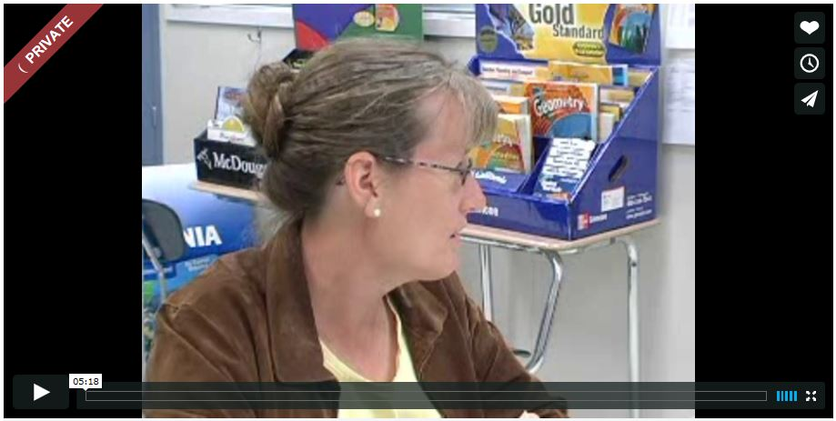
Using Evaluation Data:
Example of a Feedback Conversation
Observing Instruction to Build Capacity
Waterford High School, California
Carolyn Viss, chair of the mathematics department at Waterford High School, conducts a coaching session based on classroom observation of a core algebra class. She acknowledges good instructional practices and offers solutions for specific dilemmas. (5:18 minutes)
Video courtesy of the U.S. Department of Education’s former Doing What Works initiative.
Download video at: https://vimeo.com/84709443.
The password is DWWVideo.
Discussion: To what extent did this feedback session promote learning?
What data or evidence did Ms. Viss refer to in her questions?

Slide 32
Using Final Summative Evaluation Data for Individual and Schoolwide Planning

Slide 33
Final Summative Evaluation
Goals:
  Summarize evaluation data for individual teachers.
  Identify patterns in teacher and student performance across the school to inform the allocation of resources.
  Identify professional learning and career opportunities.
Activities:
  Analysis of individual teacher evaluation data to determine final rating(s)
  Conversations between the teacher and evaluator about performance trends and patterns
  Connection of resources, supports, and opportunities for the next evaluation cycle

Slide 34
Activity 8: Using Data to Plan for Differentiated Professional Learning
Read Handout 4, focusing on the scenario with
Ms. Blue and her summative evaluation plan.
Answer the guiding questions in Handout 4.
Outline a professional learning plan for Ms. Blue on your chart paper.
Include the following elements in your plan:
  Professional learning goals
  Professional learning activities
  Success metrics

Slide 35
Activity 9: Using Data to Plan for Schoolwide Professional Learning
Read Handout 5.
As a table group, read the final summary ratings for teachers at Orange School.
Discuss and share:
  What patterns do you see in the data?
  What are Orange School’s greatest areas
  of need?
  Based on these data, what professional learning activities would you include in a schoolwide professional learning plan?

Slide 36
What Could You Do When the Data
Are Mixed?
Collect more data.
Consider the (data) source.
Dig deeper into the data—what aspect of performance is really reflected in the numbers?
Provide professional learning to address identified areas for improvement even if some of the data indicate that the teacher does not need it.
Other

Slide 37
Using Final Summative Data
What summative data are typically collected?
Which of these data are easiest to measure or aggregate?
Which data provide the most insight into teaching and learning?
Teacher Evaluation Data
Strategic Planning
Professional Learning

Slide 38
Principles of Effective Planning Using Evaluation Data
Teacher evaluation data help ensure better allocation of resources, including teacher time.
Human judgment is an inevitable—and critical—
piece.
To fill in the gaps around the data, those closest to
the work of teaching and learning should be included in the planning.
Necessary conditions for teacher learning must exist.
Professional learning is high stakes!

Slide 39
Identifying Essential Conditions for Professional Learning

Slide 40
Essential Conditions for Effective Data Use for Planning/Assessing Professional Learning
Structural?
Cultural?
Technical?
Fiscal?

Slide 41
Essential Conditions Definitions
Structural: The policies, programs, practices and structure that need to be in place
Cultural: The necessary climate or attitude, including changes in culture, to be successful.
Technical: The technical aspects—skill, expertise, content knowledge—that are necessary to get this work done
Fiscal: The financial supports necessary to do this work or the costs associated with doing this work

Slide 42
Group Activity
In your table groups:
Select one Essential Condition per person.
Using the Post-It notes, list a challenge or condition that has to be in place to ensure effective professional learning is provided to all teachers.
Create as many Post-It notes as you can for your Essential Condition.
Discuss the challenges with your table and identify the essential conditions needed to address those challenges.
Share-out with the larger group.

Slide 43
Understanding Systemic Supports for Effective Use of Evaluation Data to Inform Professional Learning

Slide 44
Activity 10: Promising Examples of Using Data for Teacher Learning
Read Handout 6.
How do the four examples of promising practices align with the conditions for professional learning identified earlier?
What more would you like to know?
Which example is worth studying further and potentially applying in your context?
Group vote!

Slide 45

Activity 11: Pause for Self-Assessment:
Supporting High-Quality Learning
As a school or district team, respond to the questions in Handout 7: District Self-Assessment Tool.
From High-Quality Professional Development for All Teachers: Effectively Allocating Resources
(http://www.gtlcenter.org/sites/default/files/docs/HighQualityProfessionalDevelopment.pdf)

Slide 46
District Action Planning
Consider the following questions in Handout 8:
  What have I learned in this training that can be applied in my district or building?
  What are some opportunities and challenges in moving this effort forward?
  With whom in my district or building, including teacher leadership, do I share this content? Is this the same group who can implement this effort?
  What is the best way to share this module with those staff?
  What structures (policies, programs, practices) are in place that can support this effort?

Slide 47
Reflection and Wrap-Up

Slide 48
Closing the Loop
Focused
Active
Collaborative
Ongoing, Embedded, and Differentiated

Slide 49
Linking Educator Evaluation and Professional Learning
It’s Not Just About … | It’s Really About ...
Including student growth data in the evaluation system | Analyzing the results in relation to specific teaching and leadership practices
Conducting frequent, reliable observations | Meaningful, actionable feedback and conversations about how to grow
Educator effectiveness rating | Linking evaluation results to career paths, opportunities, and systems of support

Slide 50
Additional Resources
What | Resource Topic or Title | Where It’s Available
Self- Assessment | Teacher Evaluation Self-Assessment Information and Process | http://www.doe.mass.edu/edeval/training/modules/M3.pdf
Formative Evaluation | Carnegie Foundation: Feedback Conversation Protocol | http://commons.carnegiefoundation.org/wp-content/uploads/2013/08/BRIEF_Feedback-for-Teachers.pdf
Formative Evaluation | Institute of Education Sciences: Structuring Data-Informed Conversations | http://ies.ed.gov/ncee/edlabs/regions/pacific/pdf/REL_2013001.pdf
Summative Evaluation | Observation Data Collection Tool | http://bloomboard.com/schools
Publication | Generating Teaching Effectiveness: The Role of Job-Embedded Professional Development in Teacher Evaluation | http://www.gtlcenter.org/sites/default/files/docs/GeneratingTeachingEffectiveness.pdf
Publication | High-Quality Professional Development for All Teachers: Effectively Allocating Resources | http://www.gtlcenter.org/sites/default/files/docs/HighQualityProfessionalDevelopment.pdf
Publication | Linking Teacher Evaluation to Professional Development: Focusing on Improving Teaching and Learning | http://www.gtlcenter.org/sites/default/files/docs/LinkingTeacherEval.pdf

Slide 51
If you have any questions, please email at the following address: Evaluation@education.ohio.gov
Center on Great Teachers and Leaders
1000 Thomas Jefferson Street NW
Washington, DC 20007-3835
877-322-8700
gtlcenter@air.org
www.gtlcenter.org | www.air.org

