Slide 1
Student Learning Objectives: Considerations for Teachers of Career and Technical Education Courses
Name
Title
Date

Slide 2
Student Learning Objectives as a Measure of Student Growth
A student learning objective (SLO) is a measurable, long-term, academic goal informed by available data that a teacher or teacher team sets at the beginning of the year for all students or for subgroups of students.

Slide 3
Who Are Teachers of Career and Technical Education (CTE) Courses?
Teachers who link directly to an industry or occupational area and fall into the 16 Career Clusters:
Agriculture, Food, and Natural Resources
Architecture and Construction
Arts, Audiovisual Technology, and Communications
Business Management and Administration
Education and Training
Finance
Government and Public Administration
Health Science
Hospitality and Tourism
Human Services
Information Technology
Law, Public Safety, Corrections, and Security
Manufacturing
Marketing
Science, Technology, Engineering, and Mathematics
Transportation, Distribution, and Logistics

Slide 4
Why Use SLOs?
Can reinforce evidence-based teaching practices
Can be used with all teachers
Can be adaptable
Can encourage collaboration
Can be used to acknowledge the value of educator knowledge and skill
Can connect teacher practice to student learning

Slide 5
How Are SLOs Developed?
SLO Template
Baseline Data
Student Population
Interval of Instruction
Standards and Content
Assessments
Growth Targets
Rationale for Growth Targets
Instructional Strategies

Slide 6
How Are SLOs Developed? SLO Checklist
Baseline and Trend Data | Student Population | Interval of Instruction | Standards and Content | Assessments | Growth Target(s) | Rationale for Growth Target(s) | Instructional Strategies
Identifies sources of information about students Draws upon trend data, if available | Covers all students in the class (or in the case of a targeted SLO, covers all students in the subgroup) Describes the student population and considers any contextual factors that may impact student growth | Matches the length of the course (e.g., quarter, semester, trimester, year) | Specifies how the SLO will address applicable standards from the highest ranking of the following: (1) Common Core State Standards, (2) Academic content standards, (3) National standards put forth by education organizations | Identifies assessments that have been reviewed by content experts to effectively measure course content and reliably measure student learning as intended | Ensures all students in the course have a growth target Uses baseline or pretest data to determine appropriate growth | Demonstrates teacher knowledge of students and content Explains why target is appropriate for the population Addresses observed student needs Uses data to identify student needs and determine appropriate growth targets | Highlights the instructional methods that will best support the student achievement goals set forth in the SLO Discusses how the teacher will differentiate instruction in support of this SLO

Slide 7
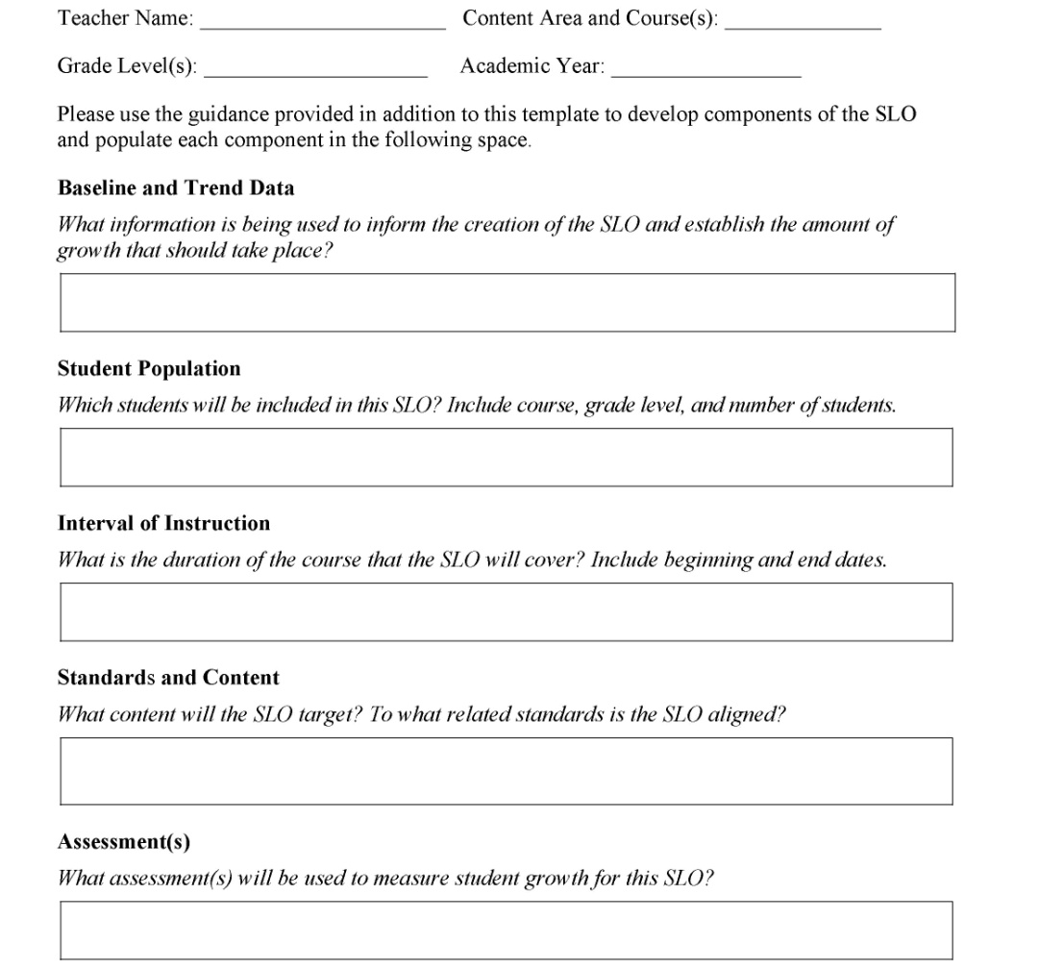
What Does an SLO Look Like? Examples From the Field: Ohio (pages 1–2 in handout)

Slide 8
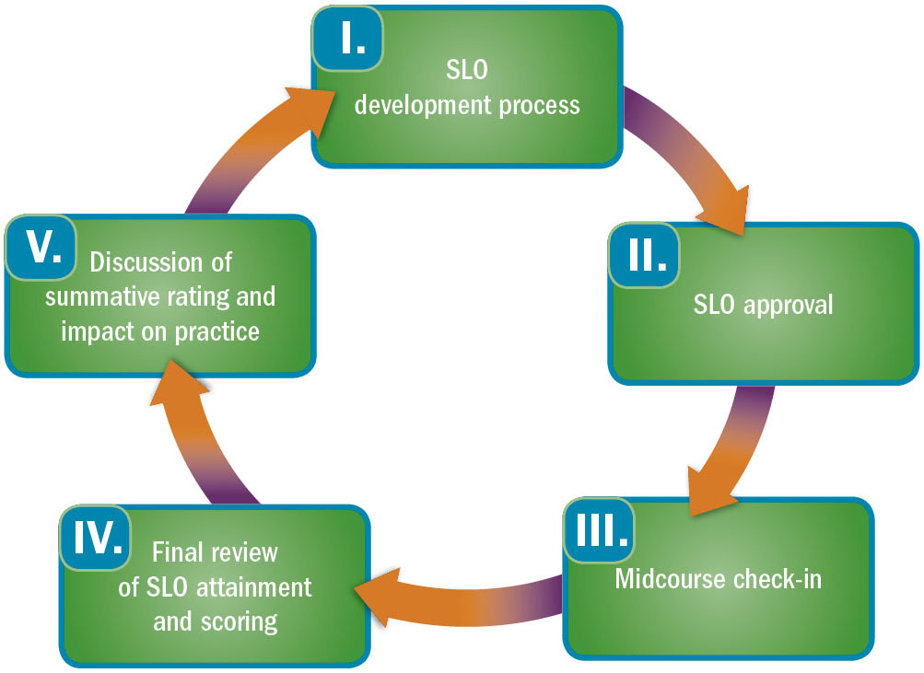
The SLO Evaluation Cycle
Source: Lachlan-Haché, L., Cushing, E., & Bivona, L. (2012). Student learning objectives as measures of educator effectiveness: The basics. Washington, DC: American Institutes for Research. Retrieved from http://educatortalent.org/inc/docs/SLOs_Measures_of_Educator_Effectiveness.pdf

Slide 9
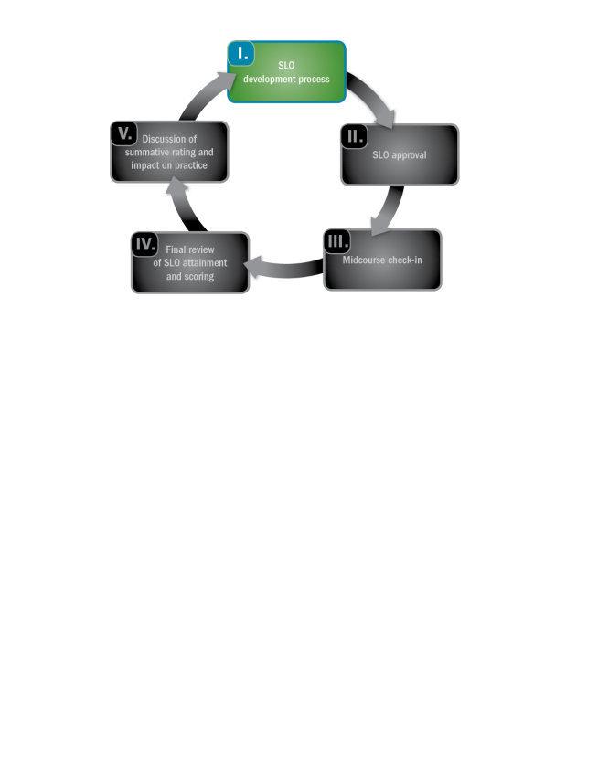
Baseline Data
SLO Template
Baseline Data
Student Population
Interval of Instruction
Standards and Content
Assessments
Growth Targets
Rationale for Growth Targets
Instructional Strategies
Baseline and trend data can be
Preassessment results
Data from previous years
Trend data from students over several years
Progress-monitoring results
Formative assessment results
Summative assessment results
The process for gathering baseline and trend data provides opportunities for collaboration.

Slide 10
Baseline and Trend Data

Slide 11
Student Population
Depending on state and local rulemaking, teachers of CTE courses may write SLOs that focus on CTE concentrators.
SLO Template
Baseline Data
Student Population
Interval of Instruction
Standards and Content
Assessments
Growth Targets
Rationale for Growth Targets
Instructional Strategies

Slide 12
Student Population
Example SLO 1
Example SLO 2

Slide 13
Interval of Instruction
The interval of instruction is the length of the course.
SLO Template
Baseline Data
Student Population
Interval of Instruction
Standards and Content
Assessments
Growth Targets
Rationale for Growth Targets
Instructional Strategies

Slide 14
Interval of Instruction
Example SLO 1
Example SLO 2

Slide 15
Standards and Content
These are the main content that students must master by the end of the course.
College and career readiness standards
Academic standards
Common Career Technical Core standards
Industry standards
SLO Template
Baseline Data
Student Population
Interval of Instruction
Standards and Content
Assessments
Growth Targets
Rationale for Growth Targets
Instructional Strategies

Slide 16
Standards and Content

Slide 17
Assessments
Assessments should have “stretch” and comparability.
Possible assessments for teachers of CTE courses
Industry certification exams
Unit assessments
End-of-course assessments
Standardized commercial assessments
Authentic assessments and work samples
SLO Template
Baseline Data
Student Population
Interval of Instruction
Standards and Content
Assessments
Growth Targets
Rationale for Growth Targets
Instructional Strategies

Slide 18
Assessments
Example SLO 1
Example SLO 2

Slide 19
Growth Targets
The type of growth targets chosen should reflect student data.
The main approaches to setting growth targets can be used with most types of assessments.
If the SLO includes multiple assessments, such as unit assessments, the growth target component of the SLO should include plans for combining scores to create a single growth target.
SLO Template
Baseline Data
Student Population
Interval of Instruction
Standards and Content
Assessments
Growth Targets
Rationale for Growth Targets
Instructional Strategies

Slide 20
Examples of SLO Growth Targets
Basic Growth Target
All students have the same growth target.
Example: All of my students will grow by 20 points by the end of the semester.

Slide 21
Examples of SLO Growth Targets
Simple Average Growth Calculation
Growth targets are determined by a common formula, but each student has a different growth target based on his or her preassessment score.
Example: Based on the preassessment score, students will score halfway between their baseline score and 100.
If student scores 50 on the preassessment, his or her growth target is 75.
If a student scores 40 on the preassessment, his or her growth target is 70.

Slide 22
Examples of SLO Growth Targets
Tiered Growth Target
Group students together based on their preassessment scores.
Divide students into three or more categories (low, middle, advanced).
Example:
Preassessment Score | Growth Score
0–45 points | 65
46–70 points | 75
71+ points | 85

Slide 23
Examples of SLO Growth Targets
Advanced Tiered Growth Target
Students have a tiered target based on their preassessment.
Divide students into three or more categories (low, middle, advanced).
Students have to reach the greater of the two targets.
Example:
Preassessment Score | Growth Score
0–45 points | 65 or +35 points, whichever is greater
46–70 points | 75 or +15 points, whichever is greater
71+ points | 85 or +14 points, whichever is greater

Slide 24
Examples of SLO Growth Targets
Individual Growth Target
All students have individualized growth targets based on previous performance and expectations.
Example: Student A will grow 27 points this year, Student B will grow 38 points this year, and Student C will grow 22 points this year.

Slide 25
Growth Targets
Example SLO 1

Slide 26
Growth Targets
Example SLO 2

Slide 27
Rationale for Targets
The rationale may describe:
How the targets align to standards.
Why the targets are appropriate.
How the targets set expectations for students’ employability or “soft skills” development.
SLO Template
Baseline Data
Student Population
Interval of Instruction
Standards and Content
Assessments
Growth Targets
Rationale for Growth Targets
Instructional Strategies

Slide 28
Rationale for Targets
Example SLO 1
Example SLO 2

Slide 29
Instructional Strategies
Identify instructional strategies that embed opportunities for collaboration.
Consider the instructional strategies that will ensure all students meet their growth target.
SLO Template
Baseline Data
Student Population
Interval of Instruction
Standards and Content
Assessments
Growth Targets
Rationale for Growth Targets
Instructional Strategies

Slide 30
Instructional Strategies
Example SLO 1

Slide 31
Instructional Strategies
Example SLO 2

Slide 32
Activity: Reviewing an SLO

Slide 33
Activity: Reviewing an SLO
In your group, choose one of the two sample SLOs to review. You can choose between a culinary arts SLO or an architecture and engineering SLO.
Using the SLO checklist, review the first draft of the sample SLO provided in the handout.
As you review, jot down questions or feedback you have for this teacher.
When finished, discuss your feedback with the person next to you.

Slide 34
Activity: Writing an SLO

Slide 35
Activity: Writing an SLO
Pretend you are a first-year digital arts and design teacher.
Review the sample data provided.
Using this information, write the SLO template provided.
Notes:
Here it would be valuable to use the template offered in the state or region so participants have an opportunity to use the required or recommended template in this activity.

Slide 36
Reflection
What do you see as the potential benefits of having teachers of CTE courses write SLOs?
What was challenging as you attempted to write this SLO?
Reflect on your experience using the SLO template and corresponding checklist. What did you like about the structure of these tools? What would you change to better fit your local context?
Based on your SLO writing experience, what supports or additional knowledge will teachers of CTE courses need to successfully write an SLO?

Slide 37
Resources
Webinar
Supporting 21st Century Educators: How States Are Promoting Career and Technical Educator Effectiveness
Brief
21st Century Educators: Developing and Supporting Great Career and Technical Education Teachers
SLO Resources
Student Learning Objectives Resource Library
Introduction to Student Learning Objectives (SLOs)

Slide 38
More questions?
Contact the GTL Center!
1000 Thomas Jefferson Street NW
Washington, DC 20007-3835
877-322-8700
www.gtlcenter.org
gtlcenter@air.org

