Slide 1
Creating Coherence Work Session: Part 2
Connecting Teacher Evaluation and Support Systems to the Common Core
[Facilitator Name(s)]
[Month Year]
Notes:
All of these materials may be used and adapted to fit the needs of the state or local context. If modifications are made to content, please use the following statement: These materials have been adapted in whole or in part with permission from the Center on Great Teachers and Leaders.
5 minutes slides 1-5.
Introduce presenters and summarize the sticky dot charts around the room as a way of introducing the participants quickly.

Slide 2
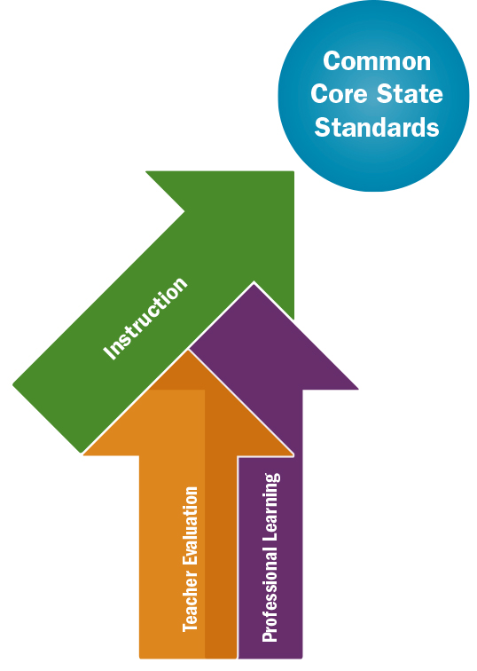
Toward Coherent Instructional Support

Slide 3
Outcomes
Participants will:
Build a shared understanding and language for addressing professional learning for the Common Core State Standards.
Elucidate and strengthen the connections between the Common Core; district teacher evaluation systems; and school and district professional development plans, offerings, and structures.
Identify any gaps in support for teachers’ instruction and discuss concrete steps to address those gaps.
Notes:
Facilitator will explain the outcomes of the training.

Slide 4
Agenda for Part 2
Insights and Priorities Identified from Part 1
Activity 6: Finishing the Team Systems Review
Activity 7: Putting It All Together
Activity 8: Action Planning and Next Steps
Activity 9: Cross-District Critical Friends
Adjourn
Notes:
Read slide.

Slide 5
Insights From Part 1
What did we learn?
Upon further reflection…
New insights?
New questions?
New concerns?

Slide 6
Activity 6: Team Systems Review (Continued)
Work in teams to complete the Systems Review (which you started in Part 1 of this work session).
For each Core Instructional Practice, complete Steps 1–4 (listed on pages 3–4 of the Creating Coherence Workbook).

Slide 7
Activity 7: Putting It All Together
Answer the questions on page 29 of the Creating Coherence Workbook.
Work in individual teams or as a whole group.

Slide 8
Activity 8: Action Planning and Next Steps
Answer the guiding questions on page 30 of the Creating Coherence Workbook.
Fill in the next steps on page 31.
Write down any additional thoughts on page 31.

Slide 9
Activity 9: Cross-District Critical Friends
Pair up with another district.
Follow this process:
District A presents an identified challenge and a proposed solution. (5 minutes)
District B provides feedback to District A. (5 minutes)
District B presents an identified challenge and a proposed solution. (5 minutes)
District A provides feedback to District B. (5 minutes)

Slide 10
Feedback and Thank You
On the Parking Lot poster, please use self-sticking notes to share the following:
Your feedback on the session
Your additional needs
Thank you for participating in this work session!

Slide 11
More questions?
Contact the GTL Center!
1000 Thomas Jefferson Street NW
Washington, DC 20007-3835
877-322-8700
gtlcenter@air.org
www.gtlcenter.org | www.air.org

