Slide 1
Collecting Evidence of Induction Program Success
[Facilitator]
[Date]
Notes:
All materials within the GTL Mentoring and Induction Toolkit may be used and adapted to fit the needs of the state or local context. If modifications are made to content, please use the following statement: These materials have been adapted in whole or in part with permission from the Center on Great Teachers and Leaders.

Slide 2
Mission
The mission of the Center on Great Teachers and Leaders (GTL Center) is to foster the capacity of vibrant networks of practitioners, researchers, innovators, and experts to build and sustain a seamless system of support for great teachers and leaders for every school in every state in the nation.
Notes:
Read the Center on Great Teachers and Leaders (GTL Center) mission statement.

Slide 3
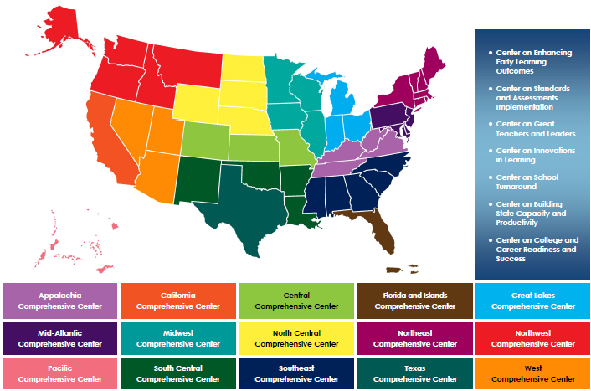
Comprehensive Centers Program
Notes:
The U.S. Department of Education’s Comprehensive Centers program consists of seven national content centers and 15 regional centers. The Center on Great Teachers and Leaders (GTL Center) is a national content center focused on educator quality that supports the 12 regional comprehensive centers shown on this slide. Sign up for the GTL Center mailing list at http://www.gtlcenter.org/content/sign-our-mailing-list.

Slide 4
Mentoring and Induction Toolkit
The purpose of the GTL Center’s Mentoring and Induction Toolkit is to give regional comprehensive centers (RCCs) and state education agencies (SEAs) tools, resources, and support to facilitate meaningful conversations with local education agencies (LEAs) to design and implement effective, high-quality mentoring and induction programs.
Notes:
This presentation is part of the Mentoring and Induction Toolkit developed by the GTL Center. Designed expressly to support states that are working closely with districts to build strong mentoring and induction (M&I) programs, this ready-to-use toolkit guides state and district leaders through the most critical aspects of developing effective M&I programs. Toolkit resources are designed to build the mentoring and induction content knowledge of school, district, state, and regional center personnel and facilitate the design and implementation of high-quality mentoring and induction programs at the district and school levels.

Slide 5
Overview of the Toolkit
Module 1: Introduction to the GTL Mentoring and Induction Toolkit
Module 2: Mentor Recruitment, Selection, and Assignment
Module 3: Mentor Professional Learning, Development, and Assessment
Module 4: Beginning Teacher Professional Learning and Development
Module 5: The Role of the Principal in Mentoring and Induction
Module 6: Mentoring and Induction for Educators of Students with Disabilities
Module 7: Collecting Evidence of Induction Program Success
Notes:
The GTL Center’s Mentoring and Induction Toolkit is divided into seven modules. This presentation is part of Module 7: “Collecting Evidence of Induction Program Success.”

Slide 6
Module Components
Anchor Presentation: Summarizes research and best practices related to the topic.
Handouts: Provide information to supplement the anchor presentation.
Team Tools: Help teams plan, design, and implement the components of a comprehensive mentoring and induction program.
Notes:
Each module consists of three components: an anchor presentation (PowerPoint), handouts (PDF or Word documents), and team tools (Word documents).

Slide 7
Access to Toolkit Materials
Anchor presentations, handouts, and team tools are available on the GTL Center website.
RCC and SEA personnel may request consultation from GTL experts to learn more about customizing the toolkit materials.
Notes:
Module materials are publicly available on the GTL Center website.

Slide 8
Module 7 Objectives
Participants will:
Build a shared understanding of effective M&I program monitoring processes
Explore how to develop an M&I program monitoring and evaluation plan that reflects your team’s specific goals, stage of readiness, and perspective
Identify GTL Center tools that can support the development of effective induction program data collection, monitoring, and continuous improvement
Notes:
Read objectives.

Slide 9
Developing an M&I Evaluation Plan
Notes:
This module provides an overview of four critical factors that support the development of successful mentoring and induction program evaluation plans. The first factor that influences successful program evaluation is stage of readiness. Teams should carefully consider how their evaluation plan reflects their stage of readiness to engage in meaningful data collection and analysis. The second factor that influences a successful program evaluation plan is clearly articulated stakeholder responsibilities. The third factor is a vision statement with an accompanying theory of change that articulates key goals, outcomes, outputs, and activities. The fourth factor is identification of available data sources to create a detailed plan for collecting and analyzing the data. Together, these factors can help local teams create effective, comprehensive mentoring and induction program monitoring and evaluation plans.

Slide 10
Articulate Stage of Readiness and Stakeholder Responsibilities
Notes:
The first section of the module will focus on strategies for articulating stage of readiness and stakeholder responsibilities within mentoring and induction program evaluation plans.

Slide 11
Factors Influencing an Evaluation Plan
Notes:
Stage of readiness and stakeholder responsibilities are the first two factors that influence mentoring and induction program evaluation plans. Different teams may be at different stages of readiness when developing an initial program evaluation plan. For example, some teams might develop their initial program evaluation plan at the same time that they are developing initial policies, procedures, and resources to guide the launch of their mentoring and induction program. Other teams might develop their program evaluation plan after they have successfully launched and implemented their program for a period of time. It’s never too late to consider developing a mentoring and induction program evaluation plan, but readiness can and should be an important factor in how teams approach the development of their plan. Depending on the stage of readiness, teams may need to involve different stakeholders in the process of identifying, collecting, and analyzing program evaluation data. These stakeholders will need to have clearly defined roles and responsibilities within the program evaluation plan.

Slide 12
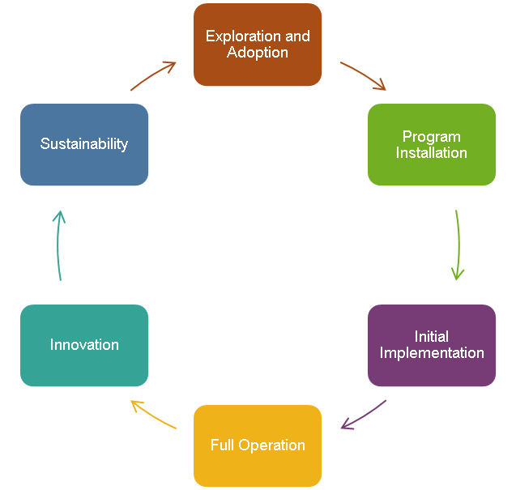
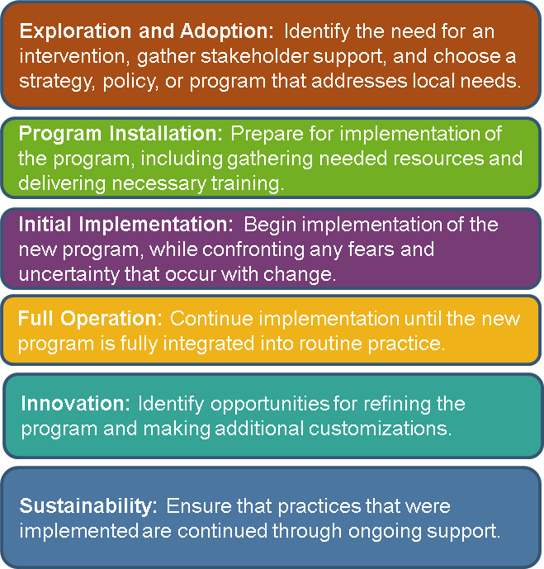
Stages of Readiness
Fixsen et al., 2005
Notes:
This slide describes the six stages of readiness from a synthesis of implementation science research conducted by Fixen, Naoom, Blase, Friedman, & Wallace (2005). The six stages of readiness are exploration and adoption, program installation, initial implementation, full operation, innovation, and sustainability. Read the definitions of the stages on the slide.

Slide 13
Example Activities in Each Stage of Readiness
Notes:
This slide list some example activities that teams might undertake when considering program evaluation efforts based on their stage of readiness. Read the example activities on the slide.

Slide 14
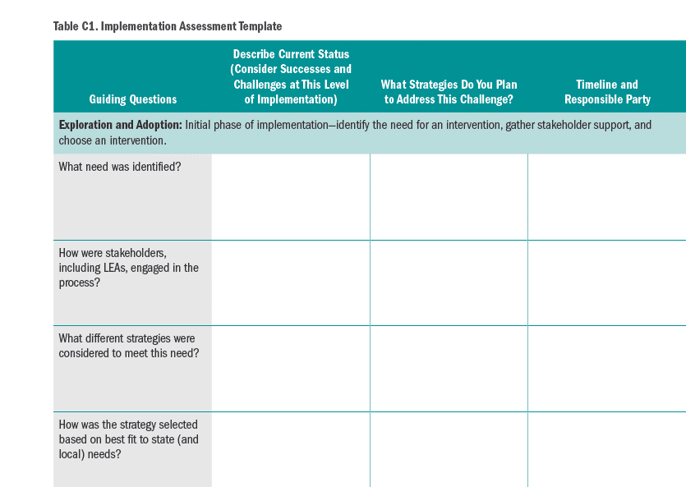
Key Resource!
GTL Center: Implementation Planning Tool
Appendix C-1 Implementation Assessment
https://gtlcenter.org/sites/ default/files/Implementation_Planning_Tool.pdf
Notes:
The GTL Center has an Implementation Assessment that can help teams reflect on their stage of readiness. The tool can be accessed in Appendix C-1 of the GTL’s Center’s Implementation Planning Tool.
https://gtlcenter.org/sites/default/files/Implementation_Planning_Tool.pdf

Slide 15
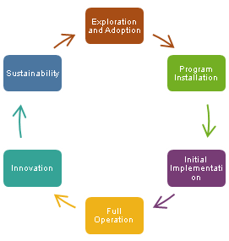
Consider Your Stage of Readiness
Which stage of readiness most reflects your team’s current status?
Why do you think this stage reflects your team’s status?
Which of the example activities from slide 13 has your team completed? Which of the example activities might your team consider as next steps?
Notes:
Discuss the questions on the slide as a team.

Slide 16
Example Stakeholder Responsibilities
State
Establish statewide policies, requirements, and points of flexibility.
Develop guidance, resources, and training.
Identify regions, districts, or schools of focus.
Articulate statewide goals and a theory of action for the M&I program.
District
Establish local policies, including policies on mentor selection criteria, mentor selection committees, and frequency of meetings.
Recruit and train mentors.
Match new teachers and mentors.
Notes:
Stakeholder responsibilities are another important factor that influence mentoring and induction program evaluation plans. This slide lists example stakeholder responsibilities for state-level stakeholders and district-level stakeholders when establishing mentoring and induction program evaluation plans.
Team discussion question: What are other stakeholder responsibilities your team should consider including in your mentoring and induction program evaluation plan?

Slide 17
Consider Your Responsibilities
What are some of your team’s primary responsibilities for implementing a quality M&I program?
Consider your team’s stage of readiness. Are there additional responsibilities that should be considered?
Notes:
Discuss the questions on the slide as a team.

Slide 18
Define a Vision Statement and Theory of Change
Notes:
The next section of the module will focus on defining a vision statement with an accompanying theory of change.

Slide 19
What Is a Theory of Change?
A theory of change is a roadmap that shows how you expect change to come about as a result of your work and provides a general picture of the project landscape. It explains how activities are understood to produce a series of results that contribute to achieving a longer term goal. A well-conceived theory of change explains how the project is understood to work and keeps implementation and evaluation transparent, so that everyone involved knows what is happening and why.
Notes:
Read slide.

Slide 20
Key Uses of a Theory of Change
Show the big picture
Show detail on the pathways to impact
Strengthen design
Assist with planning
Identify monitoring and evaluation needs
Guide data collection
Make causal claims
Tell your performance story
Mayne, 2018
Notes:
Strong theory of change statements can do the following (Mayne, 2018):
Show the big picture: A theory of change provides a visual model of how the program is expected to work.
Show detail on the pathways to impact: More than the big picture is needed for successful program implementation. Specific components of the project can be modeled in a theory of change and used for detailed analysis during the program evaluation phase.
Strengthen design: A theory of change can help team identify inconsistencies or weaknesses in the design and implementation of the program.
Assist with planning: Connects planning for program outcomes (for example, increased teacher retention) with planning for activities (for example, delivering training for mentors).
Identify monitoring and evaluation needs: Identifies what needs to be monitored and what issues should be prioritized in an evaluation plan.
Guide data collection: Provides key input into the design of data-gathering tools and processes.
Make causal claims: Provides a basis on which to make causal claims about the program’s contribution to observed results.
Tell your performance story. Provides a framework for describing how the program has performed.

Slide 21
A Theory of Change Must Be…
Plausible: It tells a compelling story about the pathway to change that leads to project goals.
Feasible: The project has the capacity and resources to implement the activities required to produce outcomes.
Supported: Stakeholders are involved in defining and refining the theory of change.
Testable: Success can be reasonably measured or observed.
Mayne, 2018
Notes:
Read slide.

Slide 22
Key Components of a Theory of Change
Vision
Communicates the vision of change to all stakeholders.
Long-Term Goals
Describes the highest-level change of the program, or the goal towards which all efforts are directed.
Short-Term Outcomes
Unpacks long-term goals by articulating the short and intermediate-term changes, results, or accomplishments that will be achieved.
Outputs
Describes products that will be created or services that will be delivered.
Key Activities
Describes the actions taken or work performed that will produce the outputs.
Notes:
There are several key components to a theory of change: a vision statement, long-term goals, short-term outcomes, outputs, and key activities. Read definitions on the slide.

Slide 23
Setting a Vision
If I do this…
then this will happen.
If I develop a quality M&I program that provides mentor teachers who understand effective teaching strategies to new hires…
then new hires will feel adequately supported and will be less likely to leave the district.
Notes:
Vision statements commonly come in the form of an if/then statement. For example, if I do this action, then this result will occur. For example, if I develop a quality M&I program that provides mentor teachers who understand effective teaching strategies to new hires, then new hires will feel adequately supported and will be less likely to leave the district.

Slide 24
Handout 1
Notes:
Handout #1 provides several examples of theory of change statements. Review Handout #1 as a team and discuss.

Slide 25
Example: State in the Initial Implementation Stage of Readiness
Theory of Change
If the state develops policies, resources, and technical assistance materials for a comprehensive M&I program…
then districts will be supported in developing quality M&I programs that meet their local teacher retention goals and expectations.
Potential Data Sources
School and district new teacher retention over time
Summative new teacher portfolio or project
Student outcomes
Notes:
This is an example of a theory of change statement that would be appropriate for a state-level team at the initial implementation stage of readiness (e.g., the state-level mentoring and induction program has been launched and is being implemented). Read the theory of change statement and potential data sources to inform the program monitoring and evaluation plan. Discuss as a team.

Slide 26
Example: District in the Initial Implementation Stage of Readiness
Theory of Change
If the district develops a comprehensive M&I program that provides quality mentors to all new teachers…
then new teachers will better understand and use effective teaching practices and feel more confident in their teaching abilities, which will make them more likely to stay in the profession.
Potential Data Sources
Summative new teacher portfolio or project
New teacher perception surveys
Mentor perception surveys
School and district new teacher retention over time
Notes:
This is an example of a theory of change statement that would be appropriate for a district-level team at the initial implementation stage of readiness (e.g., the district-level mentoring and induction program has been launched and is being implemented). Read the theory of change statement and potential data sources to inform the program monitoring and evaluation plan. Discuss as a team.

Slide 27
Example: District in the Innovation Stage of Readiness
Theory of Change
If the district develops a comprehensive M&I program that provides targeted professional learning to teachers in high-need schools…
then teacher effectiveness and culturally relevant teaching practices will increase, and there will be more equitable outcomes and experiences for students in high-needs schools.
Potential Data Sources
Student outcomes over time, with
Student feedback on new teacher effectiveness
New teacher professional development exit tickets
New teacher perception surveys
Notes:
This is an example of a theory of change statement that would be appropriate for a district-level team at the innovation stage of readiness (e.g., participants are refining and customizing the program to respond to local needs). Read the theory of change statement and potential data sources to inform the program monitoring and evaluation plan. Discuss as a team.

Slide 28
Consider Your Vision and Theory of Change
Notes:
As a team, use the Mentoring and Induction Program Theory of Change team tool template and information from this section of the module to develop a theory of change for your school or district M&I program.

Slide 29
Identify, Collect, and Analyze Data
Notes:
The next section of the module will focus on identifying, collecting, and analyzing program evaluation data.

Slide 30
Types of Data
Program quality data: Assesses whether the mentoring and induction is meeting the goals expressed in the state or district’s theory of change
Mentor quality data: Measures the quality of the mentors, including their impact on improving new teacher practice and perceptions of effectiveness among mentees
New teacher professional development quality data: Assesses the impact of the professional development provided to new teachers on changing instructional practices and overall outcomes for students
Notes:
There are several types of data of that should be considered when collecting data for mentoring and induction program evaluation efforts. Read the data type definitions on the slide and discuss as a team.

Slide 31
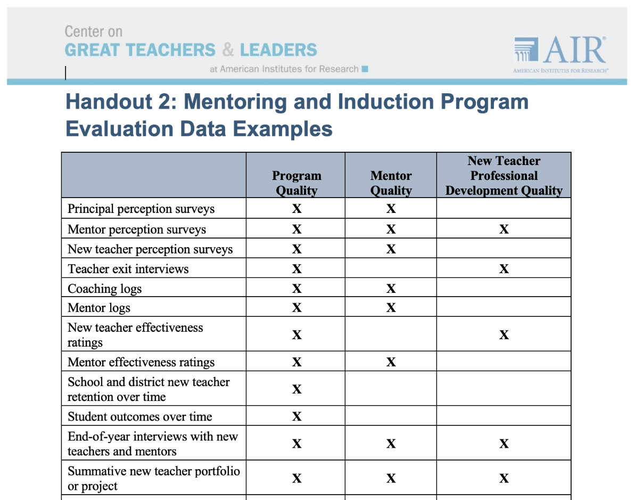
Handout 2
Notes:
Handout #2 provides examples of different types of mentoring and induction program evaluation data sources. Review Handout #2 as a team.

Slide 32
Example From the Field: Massachusetts
Report provides quantitative and qualitative data on common practices in Massachusetts induction and mentoring programs, as well as advice and resources from organizations across the state
Annual report shares district updates on key criteria:
Who are the district mentees and mentors?
How are district programs structured?
What is the districts’ program content?
How are district programs managed?
What are the district program outcomes?
Source: http://www.doe.mass.edu/educators/mentor/reports.html
Notes:
Read the example information on the slide. Click the link on the slide to explore the 2017 Massachusetts Statewide Induction and Mentoring Report (http://www.doe.mass.edu/educators/mentor/reports.html). Discuss the report as a team.

Slide 33
Example: Massachusetts Mentor Selection and Assignment Data
Notes:
This slide shows some examples of how Massachusetts collects data pertaining to the selection and assignment of mentors. Other types of data that could be collected might include information about mentor recruitment, mentor skills, and mentor training and development opportunities.

Slide 34
Example From the Field: Dallas Independent School District (DISD)
Provides new teacher support team coordinator training, which reviews the components of the New Teacher Mentoring Program and articulates best practices for teacher mentoring
Examines new teacher support data and determines implications for each campus
Shares best practices from the field
Source: http://www.dallasisd.org/Page/37643
Notes:
Read the example information on the slide. Click the link on the slide to explore more about the Dallas Independent School District New and Novice Teacher Induction Plan (http://www.dallasisd.org/Page/37643). Discuss the information as a team.

Slide 35
Example: DISD New Teacher Professional Development
Notes:
Here is one example of data collected by DISD pertaining to new teacher professional development quality. This example shows data collected from new teachers asking what they perceive as their professional development needs. Other types of data that could be collected might pertain to the frequency, quality, relevance, and usefulness of professional development opportunities provided to new teachers.

Slide 36
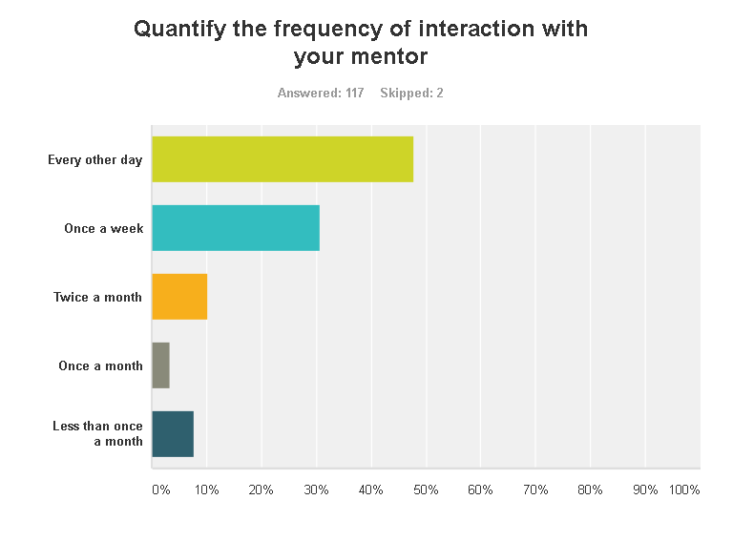
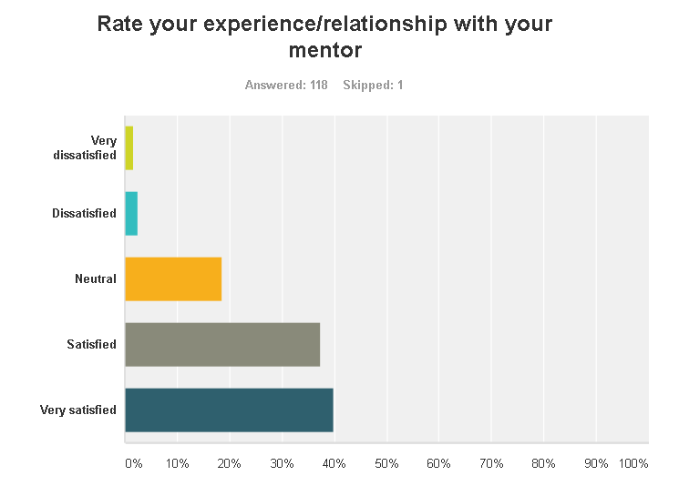
Example: DISD Mentor Support Data
Notes:
Here are some further examples of the types of data collected by the Dallas Independent School District. These data sources pertain to mentor support, specifically the frequency of interactions between new teachers and mentors and new teachers’ perceptions of the quality of their experience/relationship with their mentor.

Slide 37
Consider Your Data
Consider your team’s stage of readiness. What data are your team already collecting that could be used to inform your program evaluation plan?
What are potential sources of data that your team is not currently collecting that should be considered in your program evaluation plan?
Notes:
Discuss the questions on the slide as a team.

Slide 38
Focus on Equity
How will your program evaluation plan incorporate specific mechanisms to track progress towards M&I outcomes for new teachers in high-need, low-performing schools?
How will your team collect specific data on the needs of new teachers supporting vulnerable populations of students (e.g., students with disabilities, English language learners, students performing below grade level, etc.)?
Notes:
High-quality program evaluation plans should lead to the identification, collection, and analysis of data that can help teams make informed decisions to ensure that all students have equitable access to an effective teacher. It’s not enough for a program evaluation plan to collect data about average M&I program outcomes across a district. Program evaluation plans should pay attention to equity issues at the school level, and collect data accordingly. For example, it is not enough to collect data about the overall rates of teacher retention in a district. Program evaluation plans should put mechanisms into place specifically to collect data to see if M&I programs have led to increased retention rates in the highest-need, lowest-performing, most understaffed schools. Program monitoring and evaluation plans that specifically collect this data at the school level can provide program implementers with valuable information to make informed decisions about addressing issues of equitable access.
Discuss the questions on the slide as a team.

Slide 39
Conclusion
Notes:
Now that some examples have been shared, we are ready to conclude the module.

Slide 40
Developing an M&I Evaluation Plan
Notes:
This module has covered the four factors that influence mentoring and induction program evaluation plans: stage of readiness, stakeholder responsibilities, vision statements, and available data. When considered together, these elements can help teams create comprehensive mentoring and induction evaluation plans that are responsive to local needs and drive continuous improvement.

Slide 41
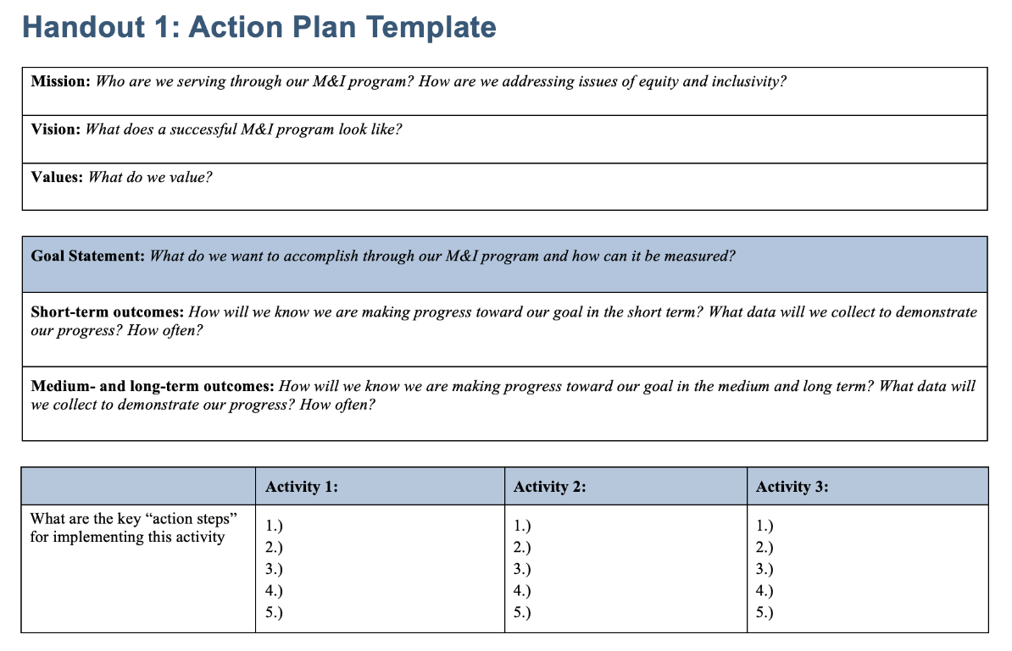
Evaluation Plan Template
GTL Center M&I Toolkit: Module 1
Mentoring and Induction Data Protocol Tool (Workbook 1)
Notes:
Teams are encouraged to incorporate program monitoring, evaluation, and data collection plans into whatever plan or template they are currently using to support M&I implementation. However, if teams would like a template for an action plan that includes program monitoring and evaluation components, please feel free to use the Action Plan Template (Handout 1) located within the Mentoring and Induction Data Protocol (Workbook 1) in Module 1 of the GTL Center’s M&I Toolkit.

Slide 42
References
Fixen, D.L., Naoom, S.F., Blase, K.A., Friedman, R.M. & Wallace, F. (2005). Implementation research: A synthesis of the literature. Tampa, FL: University of South Florida, Louis de la Parte Florida Mental Health Institute, The National Implementation Research Network (FMHI Publication #231).
Mayne, J. (2018). Developing and using useful theories of change. Evergreen briefing note. Retrieved from https://www.researchgate.net/publication/317371677_Developing_and_Using_Useful_Theories_of_Change

Slide 43
More questions?
Contact the GTL Center!
1000 Thomas Jefferson Street NW
Washington, DC 20007-3835
877-322-8700
gtlcenter@air.org
www.gtlcenter.org | www.air.org

