Slide 1
Beginning Teacher Professional Learning and Development
[Facilitator]
[Date]
Notes:
All materials within the Center on Great Teachers and Leaders (GTL Center) Mentoring and Induction Toolkit may be used and adapted to fit the needs of the state or local context. If modifications are made to content, please use the following statement: These materials have been adapted in whole or in part with permission from the Center on Great Teachers and Leaders.

Slide 2
Mission
The mission of the Center on Great Teachers and Leaders (GTL Center) is to foster the capacity of vibrant networks of practitioners, researchers, innovators, and experts to build and sustain a seamless system of support for great teachers and leaders for every school in every state in the nation.
Notes:
Read the Center on Great Teachers and Leaders (GTL Center) mission statement.

Slide 3
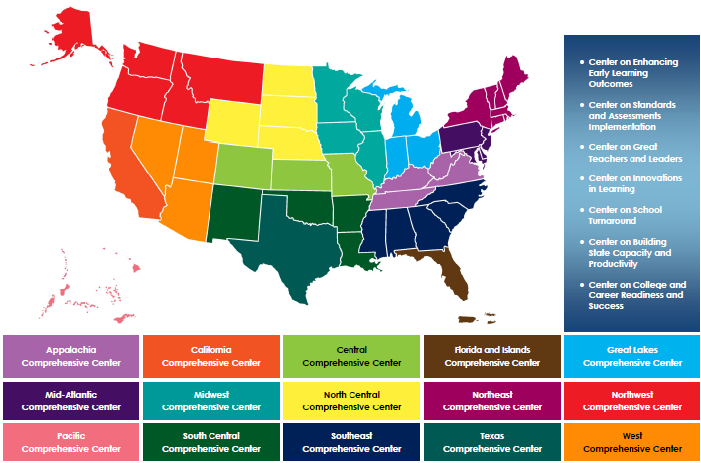
Comprehensive Centers Program
Notes:
The U.S. Department of Education’s Comprehensive Centers program consists of seven national content centers and 15 regional centers. The Center on Great Teachers and Leaders (GTL Center) is a national content center focused on educator quality that supports the 12 regional comprehensive centers shown on this slide. Sign up for the GTL Center mailing list at http://www.gtlcenter.org/content/sign-our-mailing-list.

Slide 4
Mentoring and Induction Toolkit
The purpose of the GTL Center’s Mentoring and Induction Toolkit is to give regional comprehensive centers (RCCs) and state education agencies (SEAs) tools, resources, and support to facilitate meaningful conversations with local education agencies (LEAs) to design and implement effective, high-quality mentoring and induction programs.
Notes:
This presentation is part of the Mentoring and Induction Toolkit developed by the GTL Center. Designed expressly to support states that are working closely with districts to build strong mentoring and induction (M&I) programs, this ready-to-use toolkit guides state and district leaders through the most critical aspects of developing effective M&I programs. Toolkit resources are designed to build the mentoring and induction content knowledge of school, district, state, and regional center personnel and facilitate the design and implementation of high-quality mentoring and induction programs at the district and school levels.

Slide 5
Overview of the Toolkit
Module 1: Introduction to the GTL Mentoring and Induction Toolkit
Module 2: Mentor Recruitment, Selection, and Assignment
Module 3: Mentor Professional Learning, Development, and Assessment
Module 4: Beginning Teacher Professional Learning and Development
Module 5: The Role of the Principal in Mentoring and Induction
Module 6: Mentoring and Induction for Educators of Students with Disabilities
Module 7: Collecting Evidence of Induction Program Success
Notes:
The GTL Center’s Mentoring and Induction Toolkit is divided into seven modules. This presentation is part of Module 4: “Beginning Teacher Professional Learning and Development.”

Slide 6
Module Components
Anchor Presentation: Summarizes research and best practices related to the topic.
Handouts: Provide information to supplement the anchor presentation.
Team Tools: Help teams plan, design, and implement the components of a comprehensive mentoring and induction program.
Notes:
Each module consists of three components: an anchor presentation (PowerPoint), handouts (PDF or Word documents), and team tools (Word documents).

Slide 7
Access to Toolkit Materials
Anchor presentations, handouts, and team tools are available on the GTL Center website.
RCC and SEA personnel may request consultation from GTL experts to learn more about customizing the toolkit materials.
Notes:
Module materials are publicly available on the GTL Center website.

Slide 8
Module 4 Objectives
Participants will:
Review the research base for the retention and development of beginning teachers.
Explore school- and district-based structures to create a comprehensive system of professional learning support for beginning teachers.
Define the essential features of instructionally focused formative assessment of beginning teacher practice.
Notes:
Read objectives.

Slide 9
Module Overview
Section 1: Review of the research base for beginning teacher development
Section 2: Developing comprehensive systems of support for beginning teachers
Section 3: Structures to support beginning teacher practice
Section 4: Formative assessment of beginning teacher practice
Section 5: State spotlight: Beginning teacher support systems in Hawaii
Section 6: Additional resources and references
Notes:
Review module overview.

Slide 10
Review of the Research Base for Beginning Teacher Development
Notes:
The next section of the module will review research related to the retention and development of beginning teachers.

Slide 11
The Revolving Door of Teaching
The National Center for Education Statistics’ Beginning Teacher Longitudinal Study
Percentage distribution of first-year teachers in 2007–2008 who stayed, moved schools, or left the teaching profession through 2011–2012
 | 2008–2009 | 2009–2010 | 2010–2011 | 2011–2012
Stayers | 74.2 | 74.2 | 72.3 | 70.4
Movers | 15.8 | 10.5 | 10.5 | 9.6
Leavers | 10.0 | 12.3 | 14.8 | 17.3
Source: Gray & Taie (2015)
Notes:
A common perception of the teaching profession is that there is a revolving door of beginning teachers . How accurate is this statement?
The most recent data on beginning teacher attrition and mobility during the first 5 years come from a 2015 study by the National Center for Education Statistics (NCES). This 5-year longitudinal study from NCES found that roughly 70% of first year public school teachers who had begun teaching in 2007–2008 remained in the same positions as when they started by the 2011–2012 school year. Approximately 10% of teachers in this cohort were teaching in different schools. Only 17% had completely left the profession.
Please note that the small percentages of the total group not accounted for in the 2009–2010 school year and later may be because of teachers classified as returners (defined in the study as those teaching in the year of data collection but not teaching in the previous year) or instances in which the reporting standards were not met.

Slide 12
Limitations of the Research
Longitudinal studies are difficult to conduct.
Definitions of teacher attrition vary.
Methods of calculating teacher attrition vary.
As a result, some researchers have estimated that nearly half of beginning teachers transfer to new positions or leave the teaching profession within their first 5 years of teaching (Hare & Heap, 2001; Ingersoll, 2003).
Notes:
It is important to keep in mind that every study has limitations and that defining the scope of the beginning teacher attrition is an ongoing challenge.
Some specific limitations of longitudinal studies are that they are expensive and time-consuming. These studies also encounter challenges with response rates of participants over time.
Another limitation with research on teacher attrition more broadly is that definitions and methods of calculating attrition vary. For example, studies generally use the term turnover to denote the rate at which teachers leave a school, whether to teach elsewhere (movers) or to leave the profession entirely (leavers). Some studies differentiate between movers and leavers, but not all. Also, studies inconsistently factor in the role of returners to the profession and the way that influences attrition calculations.
As a result of these research limitations, a number of studies have popularized the finding that nearly half of beginning teachers leave the teaching profession with the first 5 years. That statistic, which is attributed to researcher Richard Ingersoll, was in his words an “approximation” that he made because of limitations of the research. In a 2015 Washington Post article, Ingersoll stated that this observation was not necessarily wrong when it was first calculated; rather, there continue to be variations in the way attrition is calculated and, thus, discrepancies in attrition estimates (Brown, 2015). Please refer to the following article for more information on why attrition estimates may vary: https://www.washingtonpost.com/news/local/wp/2015/04/30/study-new-teacher-attrition-is-lower-than-previously-thought/?utm_term=.a06d439244a4
In addition, state and local data may paint a picture of teacher attrition outside the average, especially in high-needs, difficult-to-staff schools that rely on beginning teachers to meet their staffing needs. As noted in a recent report from the Learning Policy Institute on teacher supply, demand, and shortages, “Teachers with little preparation tend to leave at rates two to three times as high as of those of teachers who have had a comprehensive preparation before they enter. Teachers in high-poverty, high-minority schools tend to have higher rates of attrition, as do teachers of color, who are disproportionately represented in these schools” (Sutcher, Darling-Hammond, and Carver-Thomas, 2016). Please refer to the following link for more information: https://learningpolicyinstitute.org/sites/default/files/product-files/A_Coming_Crisis_in_Teaching_REPORT.pdf

Slide 13
Why Do Beginning Teachers Leave?
Lack of preparation
Insufficient opportunities for preservice field-based teaching experiences
Inadequate support from school administrators
Notes:
Beginning teachers leave the teaching profession for a number of reasons. Research suggests that the following are some of the most prevalent reasons:
Teacher preparation programs do not cover everything that beginning teachers need to know and be able to do when they enter the classroom for the first time (Wong & Wong, 2009). Some beginning teachers found that their teacher preparation programs did not cover certain content and skills (for example, curriculum planning or classroom management) with the depth necessary for successful teaching.
Beginning teachers engage in few to no field-based teaching experiences prior to running their own classrooms (Ingersoll, Merrill, & May, 2014). Beginning teachers may not have sufficient opportunities to engage in field-based teaching experiences in which they can get a feel for day-to-day teaching and develop their own teaching style and strategies for running their own classrooms. Field experiences for preservice teacher candidates are often insufficient in duration and lack coherence with the rest of the preservice preparation experience.
Beginning teachers receive inadequate support from school administrators (Ingersoll, 2003). Lack of support from administrators is one of the most frequent reasons why teachers transfer to different schools or leave the profession altogether.

Slide 14
What Supports Help Retain Beginning Teachers?
Comprehensive, coherent, and sustained induction programs
Ongoing opportunities to interact with and learn from peers
Support from administrators and veteran teachers
Assignment of a mentor during the first year of teaching
Notes:
Beginning teachers tend to remain in the classroom when they receive key supports. Research suggests that the following supports help to retain beginning teachers:
1. Comprehensive, coherent, and sustained induction programs as a part of onboarding to new schools and/or districts (Wong, 2004).
2. Ongoing access throughout the school year to interactions with peer teachers (both novice and veteran) in order to troubleshoot common obstacles and receive guidance for overcoming those challenges (Garet, Porter, Desimone, Birman, & Yoon, 2001; Johnson & Birkeland, 2003).
3. Support from administrators and veteran teachers (Fry, 2007).
4. Research suggests that one of the most influential supports on beginning teacher retention is mentoring. Beginning teachers benefit greatly from working closely with a mentor throughout the school year.
The 2015 National Center for Education Statistics study referred to earlier in this presentation (Gray & Taie, 2015) found that
“In each follow-up year, the percentage of beginning teachers who were currently teaching was larger among those who were assigned a first-year mentor than among those not assigned a first-year mentor (92 percent and 84 percent, respectively in 2008–09; 91 percent and 77 percent, respectively in 2009–10; 88 percent and 73 percent, respectively in 2010–11; and 86 percent and 71 percent, respectively in 2011–12)” (p. 7).
Mentoring alone only reduces 5-year attrition rates by one percentage point. Mentoring and guidance, along with scheduling common planning periods to plan lessons with colleagues and reducing new teachers' workloads by providing an aide in the classroom or having fewer preparations, can cut the attrition rate of beginning teachers by more than half—down to 18 percent (Smith & Ingersoll, 2004).
A report from the GTL Center and the National Network of State Teachers of the Year found that 68% of National and State Teachers of the Year who had an assigned or informal mentors ranked mentoring among their top three most important supports for developing teaching effectiveness. Respondents who had mentors ranked “modeled effective teaching practices” as the most important characteristic of mentors for helping beginning teachers develop effective teaching (Behrstock-Sherratt, Bassett, Olson, & Jacques, 2014).

Slide 15
Developing Comprehensive Systems of Support for Beginning Teachers
Notes:
The next section of the module will describe a theory of action for developing comprehensive systems of support for beginning teachers.

Slide 16
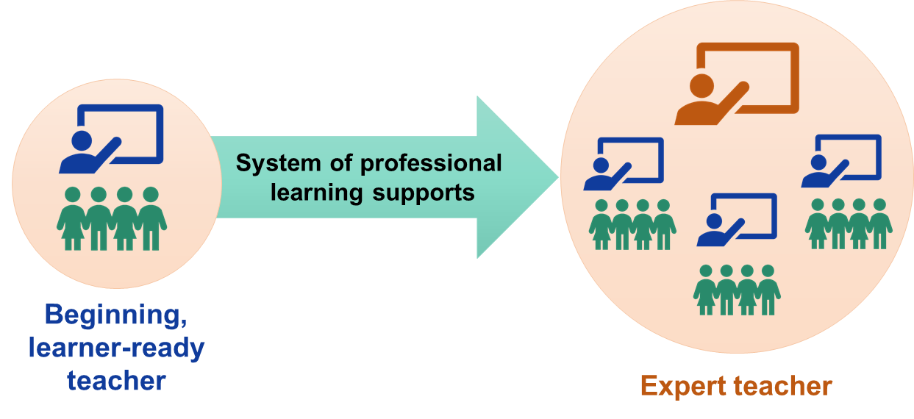
From Learner-Ready to Expert
Notes:
Teachers are expected to be learner-ready when they enter the teaching profession. The Council of Chief State School Officers (CCSSO) (2012) defines a learner-ready teacher as
“One who is ready on day one of his or her career to model and develop in students the knowledge and skills they need to succeed today, including the ability to think critically and creatively, to apply content to solving real-world problems, to be literate across the curriculum, to collaborate and work in teams, and to take ownership of their own continuous learning. More specifically, learner-ready teachers have deep knowledge of their content and how to teach it; they understand the differing needs of their students, hold them to high expectations, and personalize learning to ensure each learner is challenged; they care about, motivate, and actively engage students in learning; they collect, interpret, and use student assessment data to monitor progress and adjust instruction; they systematically reflect, continuously improve, and collaboratively problem solve; and they demonstrate leadership and shared responsibility for the learning of all students” (pp. iii-iv).
Although first-year teachers are expected to be learner-ready, they are not expected to be experts in every aspect of their jobs. A coordinated and aligned system of professional learning supports for beginning teachers (including those mentioned on the previous slide) is an essential part of their growth and development from novices to experts. This system of professional learning supports should be at its most intensive during the first 3 years of teaching, although teachers need continued professional learning supports at all stages of their development. Coordinated and aligned systems of professional learning can help to develop expert teachers who have mastered the skills to serve all learners according to their needs and can serve as teacher-leaders who guide or mentor beginning teachers to improve their practice.

Slide 17
Program Standards for Beginning Teacher Development
Download the 2018 Teacher Induction Program Standards from the New Teacher Center.
Carefully read Standards 7.0 and 8.0, noting key words and ideas.
What are some essential features of beginning teacher development highlighted in these standards?
Notes:
Download the 2018 Teacher Induction Program Standards from the New Teacher Center at http://info.newteachercenter.org/2018-program-standards

Slide 18
Structural Considerations for Beginning Teacher Development
Standard 7.0: Beginning Teacher Professional Learning, Learning Communities, and Onboarding
7.1—Comprehensive onboarding program
7.2—Beginning teacher professional learning communities
7.3—Ongoing professional learning opportunities
7.4—Mentors’ guidance for beginning teachers to apply new learning
7.5—Evaluation of beginning teacher support structures
Source: New Teacher Center (2018)
Notes:
Standard 7.0 of the 2018 Teacher Induction Program Standards from the New Teacher Center focuses on beginning teacher professional learning, learning communities, and onboarding.
7.1—Comprehensive onboarding program: School and district leaders should participate in the development and implementation of beginning teacher onboarding programs, which help orient teachers to the school and district context as well as introduce them to mentors that they will work with for the remainder of the school year.
7.2—Beginning teacher professional learning communities: Teacher learning communities must be carefully constructed, taking into account what content they will cover, what activities they will include, and how often they will meet.
7.3—Ongoing professional learning opportunities: Teacher learning communities should also enhance teachers’ professional practice by drawing on research-based practices, teaching and content standards, district instructional priorities, and the developmental needs of beginning teachers.
7.4—Mentors guide beginning teachers to apply new learning: Mentors must play an active role in helping beginning teachers apply their learning from professional development and learning communities to their practice.
7.5—Evaluation of beginning teacher support structures: Teacher learning communities must strive to remain attentive and responsive to participant needs.

Slide 19
Instructional Considerations for Beginning Teacher Development
Standard 8.0: Instructionally-Focused Formative Assessment of Beginning Teacher Practice
8.1—Formative assessment system is research-based, standards-based, and instructionally-focused.
8.2—High-leverage formative assessment tools inform ongoing teaching-coaching cycles.
8.3—Beginning teachers set instructionally-focused goals.
8.4—Mentors support beginning teachers to prioritize the school leader’s evaluation focus in ongoing formative assessment efforts.
Source: New Teacher Center (2018)
Notes:
Standard 8.0 of the 2018 Teacher Induction Program Standards from the New Teacher Center focuses on instructionally focused formative assessment of beginning teachers.
8.1—Formative assessment system is research-based, standards-based, and instructionally-focused: Formative assessment systems should be grounded in research, instruction, and content and teaching standards while also remaining responsive and accessible to mentors and beginning teachers.
8.2—High-leverage formative assessment tools inform ongoing teaching-coaching cycles: Formative assessment systems need to support mentors in carefully and thoughtfully implementing formative assessment strategies.
8.3—Beginning teachers set instructionally-focused goals: Formative assessment systems should inform beginning teachers’ professional goals and action plans.
8.4—Mentors support beginning teachers to prioritize the school leader’s evaluation focus in ongoing formative assessment efforts: Formative assessment systems should be aligned with district instructional priorities and practices for teacher performance evaluation.

Slide 20
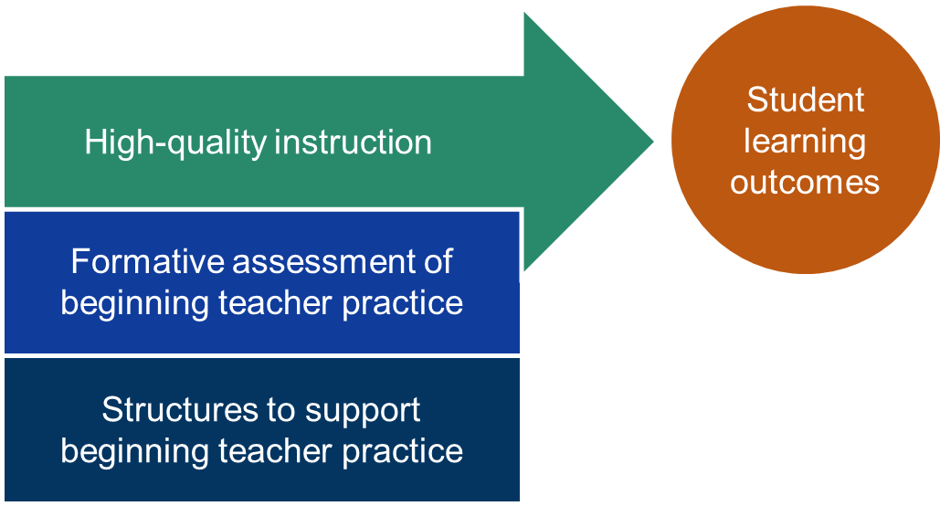
Comprehensive Systems of Support for Beginning Teachers
Notes:
This slide illustrates a theory of action for comprehensive systems of support for beginning teachers. When structures to support beginning teachers (such as onboarding, beginning teacher learning communities, ongoing professional learning opportunities, and mentoring relationships) reinforce the principles of instructionally focused formative assessment, beginning teachers are more likely to improve their instructional practice, leading to improved student outcomes. This framework is also reflected in Standards 7 and 8 of the New Teacher Center’s Teacher Induction Program Standards, detailed in the notes of the previous two slides.

Slide 21
Structures To Support Beginning Teacher Practice
Notes:
The next section of the module will take a deep dive into the structures to support beginning teacher practice outlined in Standard 7.0 of the 2018 Teacher Induction Program Standards from the New Teacher Center.

Slide 22
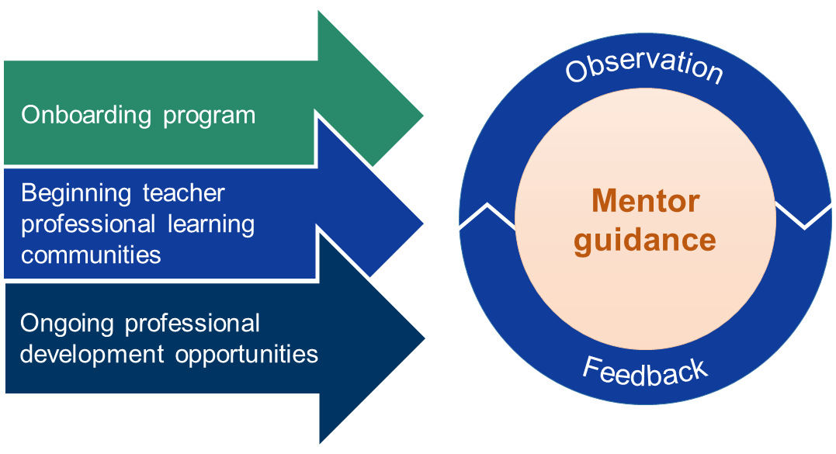
Comprehensive Systems of Beginning Teacher Support
Notes:
As noted in Standard 7.0 of the 2018 Teacher Induction Program Standards, comprehensive systems of beginning teacher support include the following structures: onboarding, beginning teacher learning communities, professional learning opportunities, and mentoring relationships. While each structure is important, mentoring relationships are particularly critical for helping beginning teachers apply the knowledge and skills they acquire through onboarding, professional learning communities, and ongoing professional learning, as illustrated in the graphic on this slide. Mentors also engage in ongoing cycles of observation and feedback to inform the support and development of beginning teachers.

Slide 23
1. Onboarding Program
Orientation for new teachers to the specific context of their district and/or school
Usually short duration support that occurs in the summer or beginning of the school year
Focused on teachers who are new to the profession but possibly also geared toward experienced teachers who are new to the school or district
Sometimes called orientation, summer academy, or new teacher institute
Notes:
An onboarding program is one of the first entry points for supporting beginning teacher development. This program is an opportunity for districts and/or schools to provide new teachers (either teachers entirely new to the profession or experienced teachers new to the school or district) with information about policies and goals specific to the context. An onboarding program typically takes place during the summer or at the beginning of the school year and is often referred to as an “orientation,” “summer academy,” or “new teacher institute.”

Slide 24
Essential Onboarding Topics
Overview of school/district philosophy
Special emphases for the year
Introduction of new teachers to their mentors
Curriculum and assessment materials
Classroom management policies
Important school/district policies
Planning for the first week of instruction
Source: Stansbury & Zimmerman (2000)
Notes:
This list summarizes key content proposed by Stansbury and Zimmerman (2000) for onboarding programs.
In addition, educators in Washington have found that high quality induction programs are sustained and purposeful, focusing in on the specific needs of beginning teachers. The Standards for Beginning Educator Induction developed by the state of Washington’s Office of Superintendent of Public Instruction provided detailed guidance for building out a beginning teacher induction program. Visit the following link for additional information: http://www.k12.wa.us/BEST/InductionStandards/?_sm_au_=iMVHg7wVR4rJ0P5M

Slide 25
Example: Onboarding Program
New Teacher Academy: Blue Valley Schools, Kansas
Time frame: 4 days
Content: Blend of sessions that introduce new teachers to district context, loop new teachers into ongoing support (mentoring and professional learning communities), and share information about content topics of interest
Topic types: Curriculum and instruction, mentoring program, and professional learning
Session topics: Culturally responsive schools, special education, whole child
Notes:
The New Teacher Academy in Blue Valley Schools, Kansas, is one example of a fully developed induction program that incorporates many of the types of onboarding topics described in the previous slide. Some of the broad topics for sessions include curriculum and instruction, mentoring program, and professional learning. Each topic has a number of associated sessions. Please visit the following links for more information about the Blue Valley Schools New Teacher Academy:
Overview: https://district.bluevalleyk12.org/employment/Pages/NewTeacherAcademy.aspx
Schedule and session descriptions: https://bvnta2017.sched.com/

Slide 26
Considerations for Onboarding
What is the essential content that must be communicated to new and beginning teachers related to
school and district community norms and policies;
curriculum, instruction, and assessment practices; and
preparing for the first day and week of school?
How will our school or district communicate the ongoing supports available to new and beginning teachers?
How will our school or district create a welcoming, trusting, and collaborative culture during onboarding?
Notes:
Discuss these considerations as a team.

Slide 27
2. Beginning Teacher Learning Communities
Notes:
Beginning teacher learning communities are another structure for supporting beginning teacher development. The defining feature of beginning teacher learning communities is the emphasis on peer-to-peer support. Beginning teacher learning communities provide beginning teachers with opportunities to share their experiences, exchange perspectives on common problems of practice, and learn from one another in a supportive, collegial environment.

Slide 28
Features of Professional Learning Communities
Supportive and shared leadership
Shared mission, vision, and values
Supportive conditions
Collective inquiry, learning, and application of learning
Shared practice
Collaborative teams
Action and results orientation and experimentation
Continuous improvement
Source: Dufour & Eaker (1998); Hord (2004)
Notes:
These features of professional learning communities are compiled from the frameworks of Dufour and Eaker (1998) and Hord (2004). Although there are some similarities between these frameworks (e.g., shared purpose, collective learning, collaborative environments), there are also some slight differences. Dufour and Eaker’s framework emphasizes the role of professional learning communities in producing specific results or outcomes and promoting continuous improvement, while Hord’s framework focuses on the role of reflective dialogue to promote participant learning. In a school setting, Dufour and Eaker might be interested in understanding the connection between beginning teachers’ participation in professional learning communities and student outcomes, while Hord would be concerned with how professional learning communities enable teachers to grow in their practice.

Slide 29
Example: Beginning Teacher Learning Community
Beginning Educator Support Team (BEST): Washington Office of Superintendent of Public Instruction
Professional development sessions tailored to the needs of first- and second-year teachers
Regular meetings with peers to share challenges and problem solve together
Notes:
Washington’s Office of Superintendent of Public Instruction developed the Beginning Educator Support Team (BEST) to provide ongoing supports for first- and second-year teachers throughout the school year. Beginning teachers have the opportunity to attend professional development sessions tailored to their needs as first- and second-year teachers. Beginning teachers also have the opportunity to meet with peers to share challenges and problem-solve as a group. Please visit the following link for additional information about BEST: http://www.k12.wa.us/BEST/default.aspx?_sm_au_=iMVHg7wVR4rJ0P5M

Slide 30
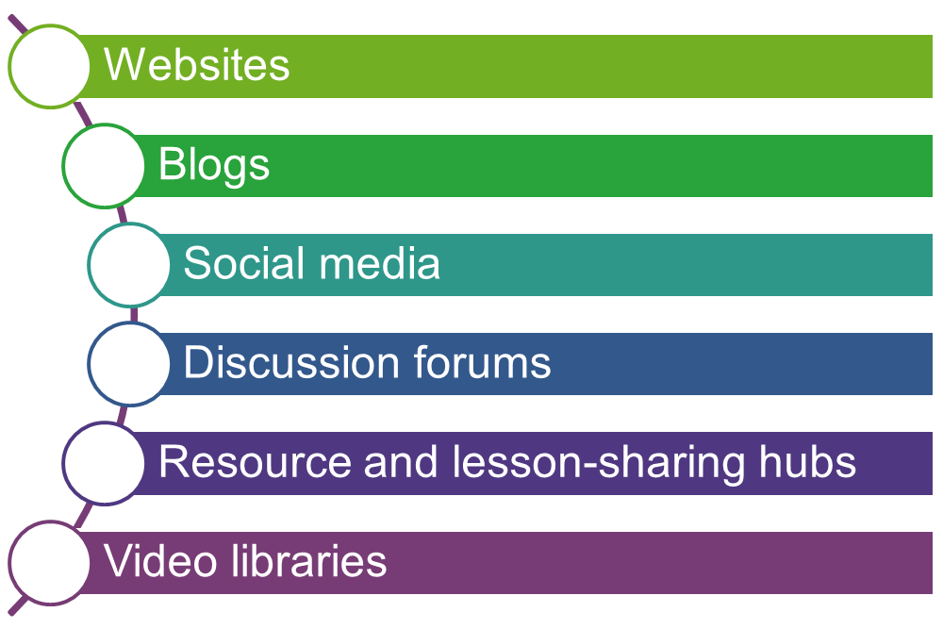
Virtual Learning Communities
Notes:
Virtual professional learning communities are becoming increasingly popular options for providing ongoing support to beginning teachers throughout the school year. Virtual professional learning communities utilize online platforms and tools such as those listed on the slide to connect beginning teachers to one another for joint problem sharing and solving.

Slide 31
Example: Virtual Learning Community
New Teacher Community: Lesley University, Massachusetts
Purpose: Provides information for new teachers and helps to foster connections between recent graduates.
Content:
Blog posts with just-in-time tips for new teachers on challenging topics
Alumni guest bloggers’ perspectives on teaching
Links to additional resources and readings
Connection with a community Facebook page
Notes:
The new teacher community at Lesley University is one example of a virtual learning community for beginning teachers. This platform offers a blend of guidance for beginning teachers and mechanisms for connecting with fellow beginning teachers. Click on the following link to view the community: http://lesleyntc.blogspot.com/?_sm_au_=iMVt12qcq6tTv7Zr
Here are a few other examples of virtual professional learning communities:
BlendEd Initiative (Nebraska)—an online platform of instructional support and professional learning: http://www.nitc.ne.gov/education_council/meetings/documents/2013.02.20/BlendEdFlyer_DRAFT.pdf
Maine Center for Best Practice—a repository of resources, videos, case studies, and online communities of practice: http://www.maine.gov/doe/cbp/
Torsh—online learning platform, video feedback, and coaching: http://www.torsh.co/

Slide 32
Considerations for Beginning Teacher Learning Communities
How can we create supportive conditions for beginning teacher professional learning communities?
How can our school/district create a space in which beginning teachers feel empowered to own their learning?
Is in-person, virtual, or a blend of both approaches the best strategy for our context?
Notes:
Discuss these considerations as a team.

Slide 33
3. Ongoing Professional Learning Opportunities
There is limited research demonstrating a positive link between teacher professional development and student achievement.
Because of the lack of research, it is important to ensure that teacher professional learning and development is grounded in a sound theory of action and high-quality planning, design, and implementation.
Notes:
Ongoing professional learning opportunities are another structure for supporting beginning teacher development. It is important to note that there is very little research about the effect of teacher professional development on student achievement. For example, a 2007 study (Yoon, Duncan, Lee, Scarloss, & Shapley, 2007) observed the following:
“Examining more than 1,300 studies identified as potentially addressing the effect of teacher professional development on student achievement in three key content areas, this report finds nine that meet What Works Clearinghouse evidence standards. That only nine meet standards attests to the paucity of rigorous studies that directly assess the effect of in-service teacher professional development on student achievement in mathematics, science, and reading and English/language arts. But the results of these studies—that average control group students would have increased their achievement by 21 percentile points if their teacher had received substantial professional development—indicated that providing professional development to teachers had a moderate effect on student achievement across the nine studies. The effect size was fairly consistent across the three content areas reviewed” (p. iii).
For more information see https:/ies.ed.gov/ncee/edlabs/regions/southwest/pdf/REL_2007033.pdf

Slide 34
Design Elements of Effective Professional Development
Is content focused.
Incorporates active learning utilizing adult learning theory.
Supports collaboration, typically in job-embedded contexts.
Uses models and modeling of effective practice.
Provides coaching and expert support.
Offers opportunities for feedback and reflection.
Is of sustained duration.
Source: Darling-Hammond, Hyler, & Gardner (2017)
Notes:
What is the most recent available research on the impact of professional development? One of the most recent studies examining this topic was conducted by Darling-Hammond, Hyler, and Gardner (2017). The study reviewed 35 methodologically rigorous studies that demonstrated a positive link among teacher professional development, teaching practices, and student outcomes. The study found the following:
“Although research on the effectiveness of professional development has been mixed, positive findings have stimulated a consensus about typical components of high-quality professional learning for teachers. This consensus, articulated by Desimone (2009) and others, holds that effective PD possesses a robust content focus, features active learning, is collaborative and aligned with relevant curricula and policies, and provides sufficient learning time for participants. Our review confirms and expands upon this five-part framework, providing additional specificity about the types of active and collaborative practices that underlie powerful teacher PD”(p. 4).
To read more about this research, click on the following link to the full report: https://learningpolicyinstitute.org/sites/default/files/product-files/Effective_Teacher_Professional_Development_REPORT.pdf

Slide 35
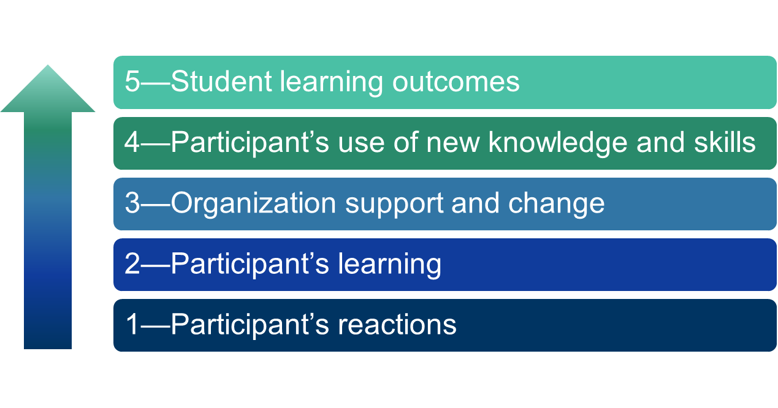
Evaluating Professional Development
Source: Guskey (2000)
Notes:
In addition to incorporating specific design elements, it is critical that professional development be evaluated in order to ensure that it is achieving its intended goals for beginning teachers. According to Guskey (2000), effective professional development evaluations require the collection and analysis of five critical levels of information, described below:
Participant’s reactions: Was it worthwhile?
Participant’s learning: Did participants acquire the intended knowledge and skills?
Organization support and change: Was implementation advocated, facilitated, and supported?
Participant’s use of new knowledge and skills: Did participants effectively apply new knowledge and skills?
Student learning outcomes: What was the impact on students?

Slide 36
ESSA Criteria for High-Quality Professional Development
Sustained
Intensive
Collaborative
Job-embedded
Data-driven
Classroom-focused
Notes:
The Every Student Succeeds Act (ESSA) defines six criteria for high-quality professional development. A 2016 report by Combs and Silverman found that “For 4 out of the 6 criteria, 80% or more of the professional development offered and participated in by teaching professionals failed to meet the federal definition.” (The full report can be accessed here: https://www.frontlineeducation.com/uploads/2018/01/ESSA_Bridging_the_Gap.pdf)
States have an opportunity to focus on the quality of teacher professional development by leveraging Title II, Part A, funds within ESSA. For more information, consider exploring the following resources:
Toolkit: A New Vision for Professional Learning: A Toolkit to Help States Use ESSA To Advance Learning and Improvement Systems, from Learning Forward and the Education Counsel: https://learningforward.org/docs/default-source/getinvolved/essa/essanewvisiontoolkit
Webinar: “Leveraging ESSA’s Title II for Job-Embedded Professional Development,” cosponsored by the Learning Policy Institute, the National Conference of State Legislatures, Learning Forward, and the National Association of State Boards of Education: https://learningpolicyinstitute.org/event/webinar-leveraging-essas-title-ii-job-embedded-professional-development
So far, a review of ESSA state plans by the GTL Center shows that 25 states plan to use funding from Title II, Part A, to support mentoring and/or induction:
Round 1 (13 states): Arizona, Connecticut, Delaware, District of Columbia, Louisiana, Maine, Massachusetts, Michigan, Nevada, New Jersey, New Mexico, Oregon, Tennessee
Round 2 (12 states): Alaska, Hawaii, Idaho, Indiana, Kansas, Mississippi, Missouri, North Dakota, Ohio, Oklahoma, Pennsylvania, Washington

Slide 37
Example: Professional Development
Professional development practices in Tennessee
Professional development is guided by priorities identified in the state strategic plan.
Multistakeholder teams meet regularly to analyze data from professional learning activities and make improvements as needed.
The SEA also uses data to analyze the impact of professional development initiatives on teacher knowledge and practice, as well as on student outcomes.
In addition, the SEA provides feedback on local professional learning efforts in need of improvement as part of technical assistance provided to school and district leaders.
Notes:
Tennessee’s approach to professional development for beginning teachers is one example of the way states are using opportunities within ESSA to focus on the quality of professional development. For more information about this example see A New Vision for Professional Learning: A Toolkit to Help States Use ESSA to Advance Learning and Improvement Systems: https://learningforward.org/docs/default-source/getinvolved/essa/essanewvisiontoolkit

Slide 38
Considerations for Professional Development
How can our state or district leverage Title II funds to support beginning teacher professional learning?
How can our districts adjust structures and processes to prioritize time for new teachers to access professional learning opportunities?
How will we evaluate the impact of beginning teacher professional learning?
Notes:
Discuss these considerations as a team.

Slide 39
4. Mentor Guidance
Teachers need opportunities to apply their learning with the guidance of a mentor.
Please refer to the following modules in the Mentoring and Induction Toolkit for additional information about mentoring programs:
Mentor Recruitment, Selection, and Assignment
Mentor Development, Assessment, and Communities of Practice
Notes:
Another structure for supporting beginning teacher development is mentor guidance. Mentors are essential for helping beginning teachers tie together and apply the knowledge and skills that they acquire through onboarding, professional learning communities, and professional learning. Mentors also provide critical, individualized support to beginning teachers with the recognition that each teacher has specific emotional needs and prior experiences.
Mentor guidance is discussed in depth in Modules 2 and 3 of the Mentoring and Induction Toolkit. Please refer to these modules for additional information on the role of mentor guidance in beginning teacher development.

Slide 40
Methods To Assess the Needs of Beginning Teachers
Classroom observations using standards-based formative assessment tools that reflect a continuum of teacher development
Needs assessment surveys of beginning teachers
Information from preservice clinical experiences
Notes:
Mentors and school leaders can use a variety of strategies to assess the needs of beginning teachers.
Classroom observations enable mentors and school leaders to experience firsthand the practices and strategies that beginning teachers are employing in the classroom, as well as to identify areas in which they may be struggling. Classroom observations should be guided by standards for teacher instruction and development.
Surveys are a useful tool for understanding the needs of beginning teachers in your context. Information from these surveys can be used to inform the focus and goals of new teacher development efforts. These surveys also provide an opportunity for beginning teachers to reflect on their practice.
Mentors and school leaders can also draw on data collected during beginning teachers’ preservice clinical experiences to develop a holistic picture of these teachers’ performance and improvement over time.

Slide 41
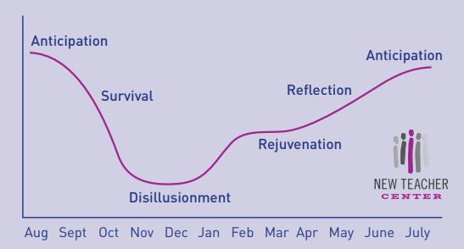
Phases of First-Year Teachers’ Attitude Toward Teaching
Source: Moir (2016)
Notes:
While beginning teachers are in need of support from mentors throughout the school year, there are certain junctures at which this support is especially critical. “Just-in-time” support at critical phases in the first year of teaching can help beginning teachers maintain a positive attitude toward teaching.
Ellen Moir, of the New Teacher Center (2016), identified six key phases in which beginning teachers particularly benefit from additional support and guidance:
Anticipation: the time period between student teaching and running his or her own classroom
Survival: the first month, when he or she is completely overwhelmed by the demands of teaching
Disillusionment: about 6 to 8 weeks after the school year begins, when the teacher feels worn down by the survival phase, as well as the introduction of new demands such as back-to-school night and parent conferences
Rejuvenation: “a slow rise in the new teacher’s attitude toward teaching” that typically follows winter break (p. 3)
Reflection: the final months of the school year when the teacher reflects on what took place during throughout the year
Anticipation: the summer months leading up to the second year of teaching
For more information, please read New Teacher Development for Every Inning from the New Teacher Center: https://newteachercenter.org/wp-content/uploads/NewTeacherDevelopmentEveryInning.pdf

Slide 42
Example: Mentoring Program
G.O.L.D.E.N. (Guidance, Orientation, Leadership, Development, Empowering New Teachers Program)
Chicago Public Schools, Illinois
Purpose: Program guidebook provides sample tasks and time lines for structuring a mentor program for beginning teachers.
Key roles:
Lead mentors
Year 1 and 2 mentors
Year 1 and 2 teachers
Notes:
The New Teacher Induction Handbook: A Guide for Principals, Mentors, and New Teachers, developed by Chicago Public Schools, provides a sample time line for structuring a mentor program for beginning teachers. The guidebook outlines roles for lead mentors, Year 1 mentors, Year 2 mentors, Year 1 teachers, and Year 2 teachers. Suggested tasks for each role typically span multiple quarters in a school year. To view the timeline, see p. 19 of the guidebook, which can be accessed at https://www.nctq.org/dmsView/4-1

Slide 43
Considerations for Mentor Guidance
How will mentors assess the needs of beginning teachers in your context?
How will mentors help beginning teachers make explicit connections across what they learn in onboarding, professional learning communities, and ongoing professional development?
Notes:
Discuss these considerations as a team.

Slide 44
Supporting Beginning Teachers in High-Need Schools
Beginning teachers in high-need schools may have specific professional learning needs based on the context of their school. These topics might include:
Culturally-responsive pedagogy
Serving students in poverty
Academic interventions and supports for students below grade level (e.g., school-wide response to intervention or multi-tiered systems of support)
Positive behavior interventions and supports
Trauma-informed teaching practices
Restorative justice
Notes:
This slide lists some of the specific professional learning needs that beginning teachers working in high-need schools might have. Beginning teachers in these schools should be provided with opportunities to address these and any other applicable topics through the available professional learning structures.

Slide 45
Formative Assessment of Beginning Teacher Practice
Notes:
Now that we have explored the different structures for supporting beginning teachers, we are going to discuss formative assessment of beginning teacher practice.

Slide 46
Revisiting a Comprehensive System of Supports
Notes:
Let’s return for a moment to the anchor graphic depicting the components of comprehensive systems of support for beginning teachers (adapted from the New Teacher Center, 2018). Instructionally focused formative assessment of beginning teacher practice, combined with structures to support beginning teacher practice, create a comprehensive system of support for beginning teachers. This support system promotes high-quality instruction and, ultimately, student learning outcomes. The previous section of this module reviewed structures to support beginning teacher practice. The next section will cover formative assessment of beginning teacher practice.

Slide 47
What is Instructionally Focused Formative Assessment?
Formal and informal processes to help teachers improve their instructional practice
Focused on teacher growth and development, with an emphasis on student learning
Processes including reflection, goal setting, analysis of student learning, and cycles of observation and feedback
Source: Office of Superintendent of Public Instruction (2018)
Notes:
At least 36 states address formative assessment of teaching practice and feedback for beginning teachers within their induction policies. State policy on formative assessment and providing actionable teaching feedback is only meaningful if it is placed at the core of mentors’ work and it helps to inform individual teachers’ development. States that exhibit the strongest policy focus and commitment to building mentor competency include California, Hawaii, Maryland, Massachusetts, North Carolina, Ohio, Oregon, and South Carolina.
Source: https://newteachercenter.org/wp-content/uploads/2016CompleteReportStatePolicies.pdf (pg. 24)

Slide 48
Five Principles of Instructionally Focused Formative Assessment
Uses standards-based tools and processes
Fosters reflection on instructional practices
Examines evidence of student learning
Features regular observation and feedback
Guides beginning teachers to benefit from formal performance evaluations
Adapted from the New Teacher Center (2018)
Notes:
Instructionally focused formative assessment is guided by five principles:
1. Formative assessment should be grounded in standards-based tools and processes.
2. Formative assessment prompts beginning teachers to reflect on their instructional practices.
3. Formative assessment examines student learning as a source of evidence for beginning teacher performance.
4. Formative assessment features regular cycles of observation and feedback from mentors.
5. Formative assessment supports should guide beginning teachers to benefit from formal performance evaluation feedback.

Slide 49
Principle 1: Standards-Based Tools and Processes
Key Actions:
Induction program leaders ensure that formative assessment systems are research based, instructionally focused, and grounded in content and teaching standards.
Induction program leaders ensure that mentors are trained to use standards-based formative assessment tools and processes to guide the growth of beginning teachers.
Notes:
Read slide.
Content standards define expectations for the knowledge and skills of students in specific content areas such as English language arts or mathematics.
Professional teaching standards outline the knowledge and skills that teachers need to provide equitable learning opportunities for all students.

Slide 50
Toolkit Connection: Part 1
Does your team need help to aligning beginning teacher professional learning priorities with standards? Try this toolkit resource!
Planning a Scope and Sequence for Beginning Teacher Professional Learning
Part 1—Review Standards and Instructional Frameworks: Helps teams identify and prioritize the standards-based instructional practices that should be continually reinforced through all beginning teacher support activities.
Notes:
Toolkit materials can be accessed on the GTL Center website: https://gtlcenter.org/.

Slide 51
Principle 2: Instructional Practices
Key Actions:
Induction program leaders identify effective instructional practices aligned with standards and instructional frameworks.
Mentors provide feedback to beginning teachers on their use of instructional practices in the classroom.
Teachers reflect on instructional feedback and make improvements to practice.
Notes:
Read slide.

Slide 52
Example
The results of Ms. Day’s latest unit assessment show that more than half of her third-grade students are struggling with multidigit subtraction. She asks her mentor, Ms. Brown, for help. Together, they identify five instructional practices for proficiency-oriented math tasks that Ms. Day will use in her reteach lesson. Ms. Brown observes the lesson and provides specific feedback on the five practices.
Extensive modeling of correct responses
Explicit instruction for conceptual understanding
Immediate and specific corrective feedback
Gradual increases in task difficulty
Gradual fading of support for correct responding
Notes:
Discuss the example on this slide as a team. How does this example reflect a focus on formative assessment of beginning teacher practice, particularly as related to instructional practice?

Slide 53
Toolkit Connection: Part 2
Does your team need help integrating instructional practices into beginning teacher professional learning? Try this toolkit resource!
Planning a Scope and Sequence for Beginning Teacher Professional Learning
Part 2—Plan Through-Lines in Beginning Teacher Professional Learning Activities: Helps teams identify and prioritize high-leverage instructional practices to reinforce throughout professional learning activities.
Notes:
Toolkit materials can be accessed on the GTL Center website: https://gtlcenter.org/.

Slide 54
Principle 3: Student Learning
Key Actions:
Teachers use multiple methods to collect evidence of student learning.
Mentors help teachers reflect on their instruction by examining student data, including work samples demonstrating evidence of student learning.
Teachers use reflections on student learning to adapt instruction.
Notes:
Read slide.

Slide 55
Student Learning Video Examples
What specific actions do mentors and teachers take to examine evidence of student learning in these video clips?
https://www.youtube.com/watch?v=mUd5VJbuD5M
https://www.youtube.com/watch?v=9XnrT4MC7fw
https://www.youtube.com/watch?v=l1bF0O13zuQ
Notes:
Watch the video clips and discuss the guiding question.

Slide 56
Principle 4: Observation and Feedback
Key Actions:
Mentors regularly observe beginning teachers, with a focus on instructional practices.
Mentors provide specific, actionable feedback to beginning teachers on their instructional practice.
Beginning teachers use the feedback to adjust their instruction.
Notes:
Read slide.

Slide 57
Observation and Feedback Video Examples
What are the six steps for effective feedback? What specific actions did mentors take to probe teachers during the feedback sessions?
https://www.youtube.com/watch?v=EBBlhoFfqwk
https://www.youtube.com/watch?v=bBeNs1Q2kXk
Notes:
Watch the video clips and discuss the guiding question.

Slide 58
Principle 5: Formal Evaluations
Key Actions:
Beginning teachers reflect on feedback from formal performance evaluations and identify next steps for growth.
Mentors help beginning teachers set goals and create professional growth plans on the basis of evaluation feedback.
Beginning teachers use formative assessment processes to monitor progress toward their goals and growth plans.
Notes:
Read slide.

Slide 59
Growth Orientation
Formative assessment and professional learning activities should help teachers grow to increasingly higher levels of performance along a continuum of development.
Notes:
There is consensus within the field that mentors should not have an evaluative role. However, there is consensus that mentors should be providing support to beginning teachers that aligns with the expectations set out in formal evaluation guidance. The support that mentors provide beginning teachers should target the areas identified for improvement through formal evaluation activities, with the goal of pushing teachers to grow to increasingly higher levels of performance. This slide shows a sample teacher development continuum showing five proficiency levels: not using, beginning, developing, applying, and innovating. Other growth-oriented evaluation models may use different levels of proficiency to define teacher performance.

Slide 60
Toolkit Connection: Part 3
Does your team need help planning for beginning teacher professional learning? Try this toolkit resource!
Planning a Scope and Sequence for Beginning Teacher Professional Learning
Part 3—Create a Scope and Sequence for Beginning Teacher Professional Learning Activities: Helps teams leverage various support structures for beginning teachers to create a comprehensive system of support, including an emphasis on instructionally focused formative assessment.
Notes:
Toolkit materials can be accessed on the GTL Center website: https://gtlcenter.org/.

Slide 61
State Spotlight: Beginning Teacher Support Systems in Hawaii
Notes:
This section will examine the way the state of Hawaii is implementing the different components of a comprehensive system of support for beginning teachers.

Slide 62
Hawaii Context
1 school district serving 180,000 students
15 complex areas
15 induction program coordinators
1,400 beginning teachers
600 mentors
Notes:
The following are some important contextual factors about Hawaii:
The Hawaii Department of Education is a statewide education system (1 school district, approximately 180,000 students).
The Hawaii Department of Education is divided into 15 Complex Areas (CAs), whose composition is comparable to Districts in others states. Each CA is made up of two to four high schools and a number of feeder elementary and middle schools.
Across the state there are approximately 1,400 beginning teachers (i.e., first- or second-year teachers) who are supported by about 600 mentoring teachers.
The Hawaii Teacher Induction Program Standards serve as a framework for a comprehensive, systemic approach to teacher induction. The standards guide CAs, to ensure a consistent bar of quality, but there is flexibility to implement programs tailored to the unique needs of each CA.
Hawaii has two policies created by the Department of Education and the Hawaii State Teachers Association (local teachers union) essentially mandating that all new teachers participate in induction programs, as guided by the standards, and that all teachers in their first or second year be provided a dedicated mentor.

Slide 63
Hawaii Teacher Induction Center
New Teacher Center mentor training
Beginning teacher professional development
Program coordinator networks
Induction program consultation
Notes:
Hawaii has a Teacher Induction Center that works with all 15 CAs to facilitate statewide mentor and beginning teacher professional development; program coordinator networks; and induction program consultation around program design, implementation, development, evaluation, and sustainability planning.

Slide 64
Onboarding Programs
Orientations take place at the Department of Education, complex area, and school levels.
Orientations emphasize the following:
Hawaii’s diverse culture and norms
School and community culture
Cultural and place-based sensitivity training
Living in Hawaii
Notes:
Teacher orientations in Hawaii provide the following:
Guided entry into the Department of Education System
Experiences to introduce new teachers to Hawaii’s diverse culture (values, norms, beliefs, practices, experiences, and language of the school and community in which they will be teaching)
Cultural, place-based sensitivity training
A community mentor to help navigate living in Hawaii

Slide 65
Beginning Teacher Summer Academy
Day 1 Content:
Classroom management
Rules, routines, and procedures
Classroom arrangement
Knowing students
Day 2 Content:
Class and school culture
Designing instruction
Questioning and discussion
Engaging students
Notes:
Beginning Teacher Summer Academies provide just-in-time professional development for beginning teachers to prepare them for a successful start to the school year. There are 10 academies, all of which are led by mentors. Academies typically last 2 days, with specific content covered on each day.

Slide 66
Special Education Beginning Teacher Summer Academy
Notes:
In addition to its summer academies for regular beginning teachers, Hawaii offers a summer academy specifically tailored to special education teachers in their first or second year of teaching.

Slide 67
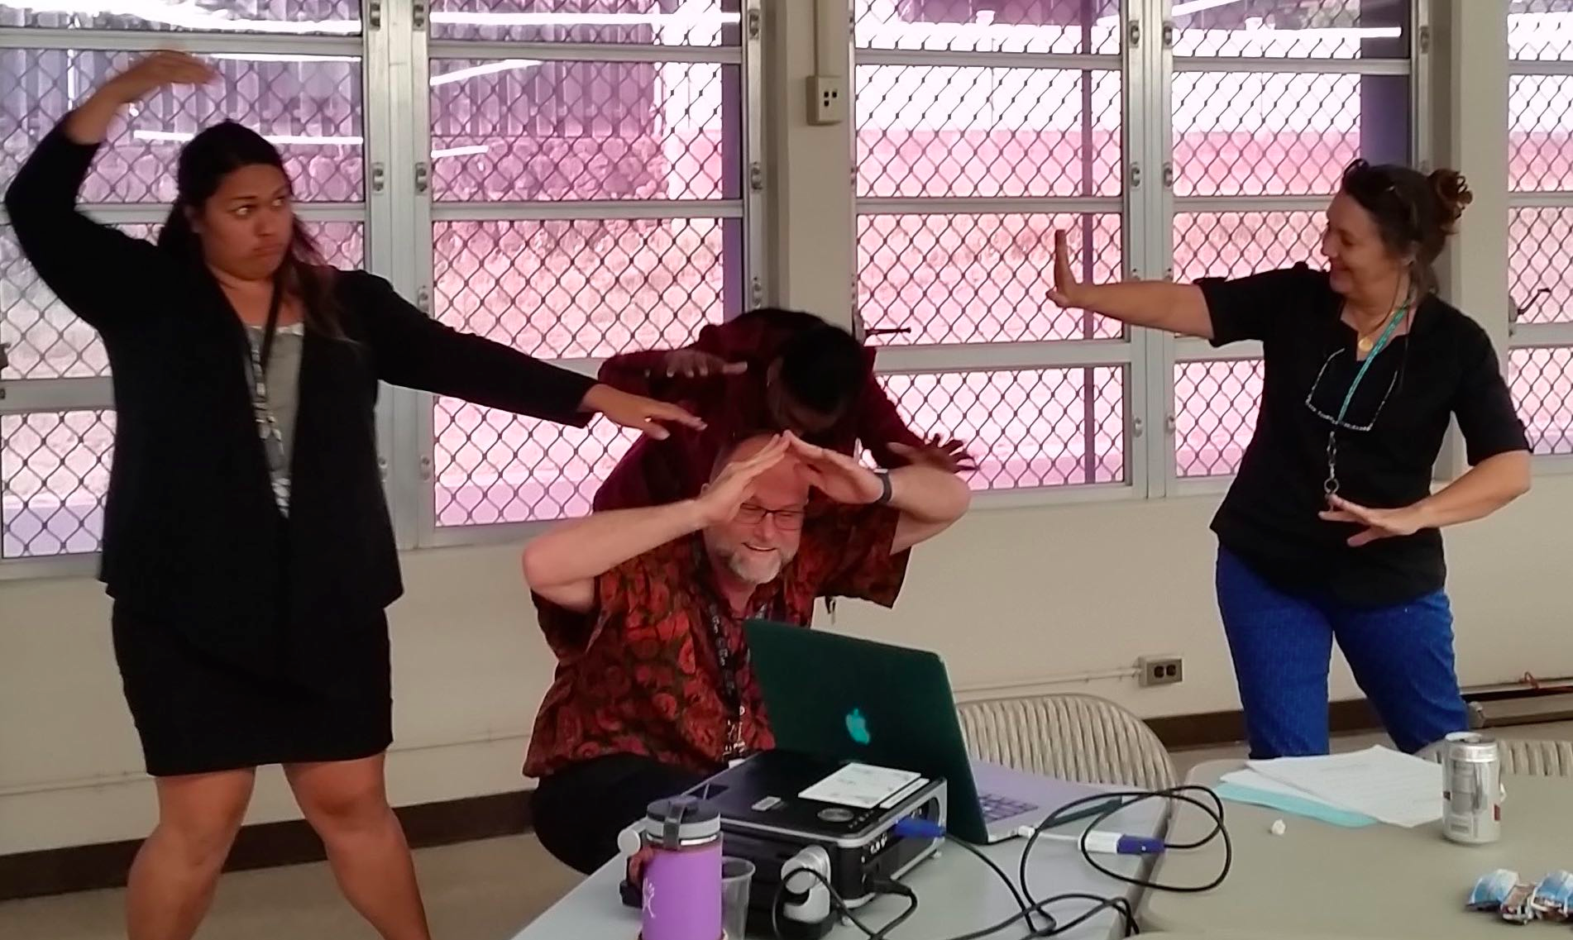
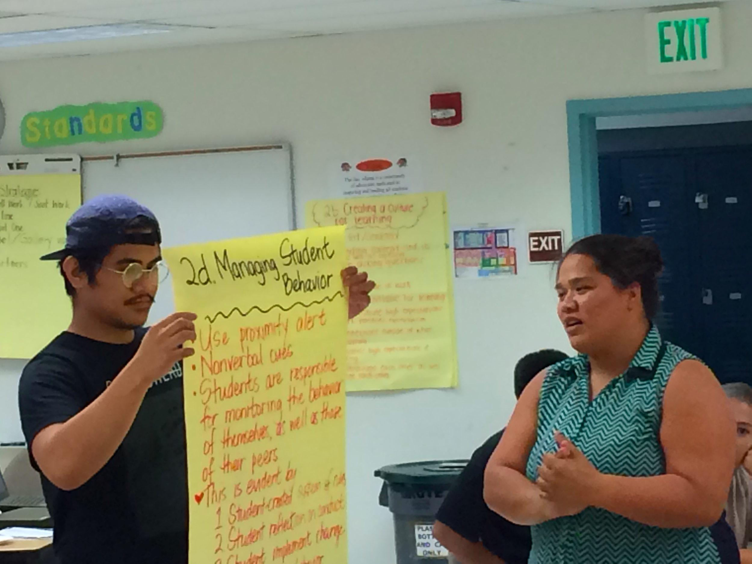
Beginning Teacher Professional Learning Communities
Honolulu Beginning Teacher PLC: arts integration, tableaus, and literacy-art connections
Maui’s beginning teachers share effective teacher practices with peers.
Notes:
Standard 4 of the Hawaii Teacher Induction Program Standards focuses on Beginning Teacher Professional Development. Hawaii holds that beginning teachers benefit most by participating in professional development targeting their needs. Professional development opportunities are aligned with the Hawaii Professional Teaching Standards and incorporate brain-friendly, active learning strategies, including time for collaboration and sharing of effective practices, as well as problems of practice.

Slide 68
Ongoing Professional Development Opportunities
West Hawaii Mentor–
Beginning Teacher Forum: sharing a digital first year of teaching reflection
Hoʻike: New teachers extend, showcase, and reflect on their learning as they explore ways to bring about integration of theory and practice.
Notes:
All beginning teachers receive content area–specific support and training through weekly instructional mentoring and additional professional development opportunities. Some of these professional development opportunities enable beginning teachers and mentor teachers to participate together. CAs hold a Ho‘ike, or a culminating celebration/exhibition to showcase what beginning teachers have learned.

Slide 69
Mentor Guidance
Weekly mentoring for 2 years
Formative assessment system
Professional growth plan
Focus on high-leverage mentoring tools and strategies
Facilitation of effective teacher observations
Notes:
Mentor support for beginning teachers in Hawaii is sustained and job embedded. All new mentors participate in rigorous mentor training that focuses on developing their skills, knowledge, and disposition to serve as effective instructional mentors for beginning teachers.

Slide 70
Reflection
What elements make Hawaii’s beginning teacher system of support a comprehensive one?
How does mentoring help integrate the other beginning teacher support structures in Hawaii?
Notes:
Discuss the reflection questions.

Slide 71
Additional Resources and References

Slide 72
Additional Resources for Beginning Teachers
Blythe, T., Allen, D., & Schiefelin Powell, B. (1999). Looking together at student work: A companion guide to assessing student learning. New York, NY: Teachers College Press.
U.S. Department of Education. Survival guide for new teachers. https://www2.ed.gov/teachers/become/about/survivalguide/ resources.html
Edutopia. https://www.edutopia.org/blogs/tag/new-teachers
Schwartz, S. (2018, August). Don’t be afraid to ask questions: 5 tips for new teachers. http://blogs.edweek.org/teachers/teaching_now/2018/08/5_tips_for_new_teachers.html?cmp=eml-enl-eu-news2-rm&M=58578827&U=1424234
Stephens, L. (n.d.). 3 truths I wish I’d known as a first-year teacher. http://news.ets.org/stories/3-truths-wish-id-known-first-year-teacher/
Whitaker, T. (2003). What great teachers do differently: 14 things that matter most. Larchmont, NY: Eye on Education, Inc.
Wong, H. K., & Wong, R. T. (2009). The first days of school: How to be an effective teacher. Mountain View, CA: Harry K. Wong Publications, Inc.

Slide 73
References
Behrstock-Sherratt, E., Bassett, K., Olson, D., & Jacques, C. (2014). From good to great: Exemplary teachers share perspectives on increasing teacher effectiveness across the career continuum. Washington, DC: Center on Great Teachers and Leaders. Retrieved from https://files.eric.ed.gov/fulltext/ED555657.pdf
Brown, E. (2015, April 30). Study: Far fewer new teachers are leaving the profession than previously thought. The Washington Post. Retrieved from https://www.washingtonpost.com/news/local/wp/2015/04/30/study-new-teacher-attrition-is-lower-than-previously-thought/?utm_term=.a06d439244a4
Combs, E., & Silverman, S. (2016). Bridging the gap: Paving the pathway from current practice to exemplary professional learning. Frontline Education. Retrieved from https://www.frontlineeducation.com/uploads/2018/01/ESSA_Bridging_the_Gap.pdf
Council of Chief State School Officers (CCSSO). (2012). Our responsibility, our promise: Transforming educator preparation and entry into the profession. Washington, DC: Council of Chief State School Officers (CCSSO). Retrieved from https://www.ccsso.org/sites/default/files/2017-10/Our%20Responsibility%20Our%20Promise_2012.pdf

Slide 74
References (continued)
Darling-Hammond, L., Hyler, M. E., & Gardner, M. (2017). Effective teacher professional development. Palo Alto, CA: Learning Policy Institute. Retrieved from https://learningpolicyinstitute.org/sites/default/files/product-files/Effective_Teacher_Professional_Development_REPORT.pdf
Desimone, L. M. (2009). Improving impact studies of teachers’ professional development: Toward better conceptualizations and measures. Educational Researcher, 38(3), 181-199.
Dufour, R., & Eaker, R. (1998). Professional learning communities at work: Best practices for enhancing student achievement. Alexandria, VA: Association for Supervision and Curriculum Development.
Fry, S. W. (2007). First-year teachers and induction support: Ups, downs, and in-betweens. The Qualitative Report, 12(2), 216–237.
Garet, M., Porter, A., Desimone, L., Birman, B., & Yoon, K. (2001). What makes professional development effective? Results from a national sample of teachers. American Educational Research Journal, 38(4), 915–945. https://www.air.org/sites/default/files/downloads/report/aera_designing_0.pdf

Slide 75
References (continued)
Gray, L., & Taie, S. (2015). Public school teacher attrition and mobility in the first five years: Results from the first through fifth waves of the 2007—08 beginning teacher longitudinal study (NCES 2015-337). U.S. Department of Education. Washington, DC: National Center for Education Statistics. Retrieved from https://nces.ed.gov/pubs2015/2015337.pdf
Guskey, T. R. (2000). Evaluating professional development. Thousand Oaks, CA: Corwin Press, Inc.
Hare, D., & Heap, J. (2001). Effective teacher recruitment and retention strategies in the Midwest. Naperville, IL: North Central Regional Laboratory. Retrieved from https://files.eric.ed.gov/fulltext/ED477648.pdf
Hord, S. M. (2004). Professional learning communities: An overview. In Shirley Hord, Ed., Learning together, leading together: Changing schools through professional learning communities (pp. 5–14). New York, NY: Teachers College Press.
Ingersoll, R. (2003). Is there really a teacher shortage? Philadelphia, PA: University of Pennsylvania, Consortium for Policy Research in Education (CPRE). Retrieved from https://repository.upenn.edu/cgi/viewcontent.cgi?article=1133&context=gse_pubs

Slide 76
References (continued)
Ingersoll, R., Merrill, L., & May, H. (2014). What are the effects of teacher education and preparation on beginning teacher attrition? Philadelphia, PA: Consortium for Policy Research in Education (CPRE). Retrieved from http://www.cpre.org/sites/default/files/researchreport/2018_prepeffects2014.pdf
Johnson, S., & Birkeland, S. (2003). Pursuing a sense of success: New teachers explain their career decisions. American Educational Research Journal, 40(3), 581–617.
Moir, E. (2016). New teacher development for every inning. Santa Cruz, CA: The New Teacher Center. Retrieved from https://newteachercenter.org/wp-content/uploads/NewTeacherDevelopmentEveryInning.pdf
Office of Superintendent of Public Instruction. (2018). Standards for beginning educator induction: Effective support for Washington state educators. Olympia, WA. Retrieved from http://www.k12.wa.us/BEST/InductionStandards/pubdocs/InductionStandards.pdf?_sm_au_=iMVHg7wVR4rJ0P5M
Skerrett, A. (2010). There’s going to be community. There’s going to be knowledge: Designs for learning in a standardized age. Teaching and Teacher Education, 26, 648.

Slide 77
References (continued)
Smith, T. M., & Ingersoll, R. M. (2004). What are the effects of induction and mentoring on beginning teacher turnover? American Educational Research Journal, 41(3), 681–714.
Stansbury, K. & Zimmerman, J. (2000). Lifelines to the classroom: Designing support for beginning teachers. San Francisco, CA: WestEd.
Sutcher, L., Darling-Hammond, L., & Carver-Thomas, D. (2016). A coming crisis in teaching? Teacher supply, demand, and shortages in the U.S. Palo Alto, CA: Learning Policy Institute. Retrieved from https://learningpolicyinstitute.org/sites/default/files/product-files/A_Coming_Crisis_in_Teaching_REPORT.pdf
The New Teacher Center. (2018). Teacher induction program standards: A guiding framework for teacher induction program leaders. Santa Cruz, CA: The New Teacher Center. Retrieved from http://info.newteachercenter.org/2018-program-standards
Wong, H. K. (2004). Induction programs that keep new teachers teaching and improving. NASSP Bulletin, 88(638), 41–58. Retrieved from http://journals.sagepub.com/doi/pdf/10.1177/019263650408863804

Slide 78
References (continued)
Wong, H. K., & Wong, R. T. (2009). The first days of school: How to be an effective teacher. Mountain View, CA: Harry K. Wong Publications, Inc.
Yoon, K. S., Duncan, T., Lee, S. W. Y., Scarloss, B., & Shapley, K. L. (2007). Reviewing the evidence on how teacher professional development affects student achievement. Issues & answers. REL 2007-No. 033. Regional Educational Laboratory Southwest (NJ1). Retrieved from https://ies.ed.gov/ncee/edlabs/regions/southwest/pdf/REL_2007033.pdf

Slide 79
More questions?
Contact the GTL Center!
1000 Thomas Jefferson Street NW
Washington, DC 20007-3835
877-322-8700
gtlcenter@air.org
www.gtlcenter.org | www.air.org

