Slide 1
Mentoring and Induction for Educators of Students With Disabilities
  [Facilitator]
    [Date]
Notes:
All materials within the GTL Mentoring and Induction Toolkit may be used and adapted to fit the needs of the state or local context. If modifications are made to content, please use the following statement: These materials have been adapted in whole or in part with permission from the Center on Great Teachers and Leaders.

Slide 2
Mission
The mission of the Center on Great Teachers and Leaders (GTL Center) is to foster the capacity of vibrant networks of practitioners, researchers, innovators, and experts to build and sustain a seamless system of support for great teachers and leaders for every school in every state in the nation.
Notes:
Read the Center on Great Teachers and Leaders (GTL Center) mission statement.

Slide 3
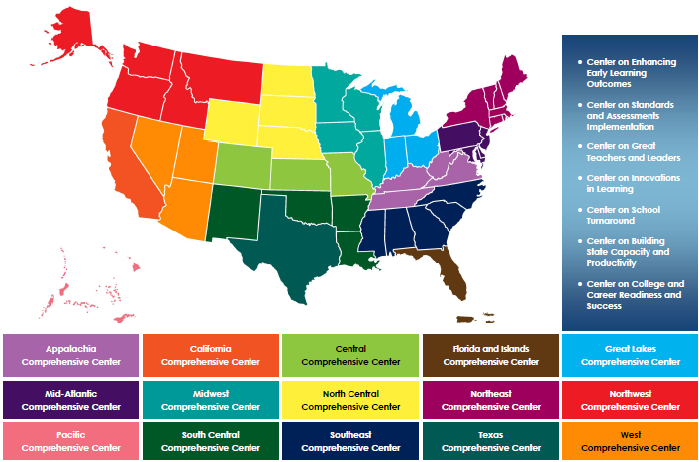
Comprehensive Centers Program
Notes:
The U.S. Department of Education’s Comprehensive Centers program consists of seven national content centers and 15 regional centers. The Center on Great Teachers and Leaders (GTL Center) is a national content center focused on educator quality that supports the 12 regional comprehensive centers shown on this slide. Sign up for the GTL Center mailing list at http://www.gtlcenter.org/content/sign-our-mailing-list.

Slide 4
Mentoring and Induction Toolkit
The purpose of the GTL Center’s Mentoring and Induction Toolkit is to give regional comprehensive centers (RCCs) and state education agencies (SEAs) tools, resources, and support to facilitate meaningful conversations with local education agencies (LEAs) to design and implement effective, high-quality mentoring and induction programs.
Notes:
This presentation is part of the Mentoring and Induction Toolkit developed by the GTL Center. Designed expressly to support states that are working closely with districts to build strong mentoring and induction (M&I) programs, this ready-to-use toolkit guides state and district leaders through the most critical aspects of developing effective M&I programs. Toolkit resources are designed to build the mentoring and induction content knowledge of school, district, state, and regional center personnel and facilitate the design and implementation of high-quality mentoring and induction programs at the district and school levels.

Slide 5
Overview of the Toolkit
Module 1: Introduction to the GTL Mentoring and Induction Toolkit
Module 2: Mentor Recruitment, Selection, and Assignment
Module 3: Mentor Professional Learning, Development, and Assessment
Module 4: Beginning Teacher Professional Learning and Development
Module 5: The Role of the Principal in Mentoring and Induction
Module 6: Mentoring and Induction for Educators of Students with Disabilities
Module 7: Collecting Evidence of Induction Program Success
Notes:
The GTL Center’s Mentoring and Induction Toolkit is divided into seven modules. This presentation is part of Module 6: “Mentoring and Induction for Educators of Students With Disabilities.”

Slide 6
Module Components
Anchor Presentation: Summarizes research and best practices related to the topic.
Handouts: Provide information to supplement the anchor presentation.
Team Tools: Help teams plan, design, and implement the components of a comprehensive mentoring and induction program.
Notes:
Each module consists of three components: an anchor presentation (PowerPoint), handouts (PDF or Word documents), and team tools (Word documents).

Slide 7
Access to Toolkit Materials
Anchor presentations, handouts, and team tools are available on the GTL Center website.
RCC and SEA personnel may request consultation from GTL experts to learn more about customizing the toolkit materials.
Notes:
Module materials are publicly available on the GTL Center website.

Slide 8
Module 6 Objectives
Strengthen collaboration and shared investment between SEAs, LEAs, and educator preparation programs (EPPs) in M&I programs that span across preservice and inservice.
Establish consistency in expectations of instructional practice that offer all students equitable access to the general education curriculum.
Promote evidence-based/high-leverage instructional practices and provide teacher candidates and novice teachers with practice-based opportunities to advance their practice.
Notes:
This module was designed to accomplish three things: (1) the promoting of shared investment in the creation of M&I programs that span preservice and inservice, including specific roles and responsibilities for all partners (e.g., educator preparation programs, EPPs; state education agencies, SEAs; and local education agencies, LEAs); (2) the establishment of consistency in expectations of instructional practices designed to promote the access of all students to the general education curriculum—with a specific focus on students with disabilities; and (3) the design of an M&I model that is grounded in evidence-based/high-leverage instructional strategies and that offers teacher candidates and novice teachers multiple practice-based opportunities to advance their practice.

Slide 9
Why Focus On Teachers Of Students With Disabilities?
Notes:
Facilitate a short, open discussion with the team.
Why is it important to focus on teachers of students? Ask each partner to talk for 30 seconds about why it might be important to focus on students with disabilities within a mentoring and induction module. One partner responds while the other remains quiet. At the end of the 30 seconds, the listening partner responds to what she/he heard (15 seconds). Then partners switch.
What challenges could be addressed by designing an M&I model that targets supporting teachers of students with disabilities? Follow same format as above.
Have the lead facilitate a short group share-out. This will get the participants engaged and set up the following section by either confirming or adding to what was shared.

Slide 10
The Context
Increasingly diverse classrooms—with a diverse set of backgrounds and learning needs.
Achievement gap persists between students with disabilities and their same-age peers; gap has existed for decades with little improvement (Vaughn & Wanzek, 2014).
In 2005–2006, 40% of schools in 16 states missed Annual Yearly Progress either partially or solely due to SWD performance (Harr-Robins et al., 2012).
Notes:
Today’s classrooms are full of students with diverse backgrounds and learning needs. The need is ever-present for teachers to address those individual student needs by providing high-quality instruction through differentiation.
Achievement gaps for students with disabilities and their same-age peers persist—even with a decade of policies and initiatives focused on improving teacher quality.
Requirements within the Every Student Succeeds Act (ESSA)—and formerly under No Child Left Behind (NCLB)—requires the reporting of student achievement among student subgroups; students with disabilities are one of those subgroups. This has shone a spotlight on the pervasive achievement gap and prevented schools from meeting annual yearly project (AYP) benchmarks (under NCLB), resulting in some historically high-performing schools and districts falling into low-performing status due to the achievement of students with disabilities. In 2012, Harr-Robins and colleagues found that 40% of schools in 16 states missed AYP either partially or solely due to SWD performance. While no such studies yet exist under the states’ new ESSA accountability requirements, it is likely that SWDs’ academic performance will result in schools and districts being identified as low performing, with states needing to provide both comprehensive and targeted systems of support as required within ESSA.

Slide 11

The Challenge
19–30% of new teachers leave the profession within their first 5 years (Sutcher, Darling-Hammond, Carver-Thomas, 2016).
Special education teachers are 2.5 times more likely to leave teaching (Smith & Ingersoll, 2004).
Teacher shortages are prevalent; supply has dwindled over the years, and states have lowered certification and licensure standards as a result (Papay et al., 2018).
Districts are left with few choices, and rely on “fast-track” and emergency certified teachers with little preparation and classroom experience.
Notes:
The Learning Policy Institute reports that 19–30% of all teachers leave the profession within their first five years. Special education teachers are 2.5 times more likely to leave the profession than their general education peers. At the same time, teacher shortages are prevalent in most states, with supply dwindling, resulting in states lowering certification and licensure standards. The reality is that districts are left with few choices other than to rely on “fast-track” and emergency-certified teachers with little preparation and classroom experience. All this together speaks to the need for high-quality M&I programs—not only to retain teachers, but also to ensure that all students are provided equitable access to the general education curriculum and are afforded equitable opportunities to reach proficiency standards.

Slide 12
The Challenge (continued)
General education teachers play a primary role in the education of SWDs, but often report feeling unprepared to take this role (Cameron & Cook, 2007).
On average, general education teachers are offered only 1.5 courses that address SWDs, and only 23 states require general education teacher candidates to have clinical experiences involving SWDs (Goldrick, Sindelar, Zabala, & Hirsh, 2001).
Notes:
Approximately 60% of SWDs receive instruction in the general education classroom. This context is important to note because it is not only special education teachers that need to be prepared and supported to meet the needs of SWDs, but also general education teachers. That said, general educators continue to report that they feel unprepared to take on this role and that they have been provided little preparation and experience with SWDs throughout their preparation programs. This lack of preparation likely results in a lack of confidence among general educators that can lead to increasing referrals to special education, inequitable access to the general education curriculum, and poor learning outcomes for SWDs.

Slide 13
The Challenge (continued)
Special educators frequently cite a lack of shared ownership of students with disabilities and role ambiguity as reasons for leaving the profession (Holdheide & DeMonte, 2016).
General education and special education teachers are often prepared separately, with little opportunity to learn and apply collaboration skills.
Leaders are not prepared to establish inclusive buildings and classrooms, and often fail to set up an infrastructure that facilitates collaboration and shared ownership.
Notes:
General educators’ lack of preparation and confidence in supporting SWDs also contributes to special education teacher attrition. For one thing, this lack of preparedness can foster decreased ownership of SWDs and their learning among general educators. Second, this lack of shared ownership can undermine efforts for general and special educators to collaborate, resulting in a lack of clarity in roles and missed opportunities to leverage expertise strategically across teachers. Moreover, poor core instruction can result in more students needing specialized and intensive intervention and supports, which prevents the effective use of a multi-tiered system of support—as described further in subsequent slides. And finally, school leaders may not be adequately prepared to establish an inclusive environment and may fail to set up an infrastructure that facilitates increased collaboration and shared ownership among general and special educators.

Slide 14
The Challenge (continued)
Initial preparation is insufficient to ensure that teachers have the skills to implement evidence-based teaching practices (Leko, Brownell, Sindelar, & Kiely, 2015).
Professional development is more effective when it is focused, occurs over time, and is coherent (Benedict, Holdheide, Brownell, & Foley, 2016).
Consistent expectations of instructional practice from preservice to inservice, paired with multiple practice-based opportunities, are more likely to improve teacher practice (Benedict et al., 2016; Billingsley, Bettini, & Jones, in press).
Notes:
Common sense and research confirm that initial teacher preparation is not enough to ensure that teachers can implement instructional practices—most particularly evidence-based practices—with fidelity. Moving teachers from novices to experts requires training, professional learning, and support that is focused, occurs over time, and is coherent. Likewise, providing consistent expectations of instructional practice from preservice to inservice that are paired with multiple practice-based opportunities is more likely to lead to improved teacher practice.

Slide 15
The Opportunity
Mentoring and induction can be used to:
  Facilitate partnerships among SEAs, LEAs, and EPPs
  Establish consistent expectations of instructional practice from preservice to inservice
  Provide multiple, practice-based opportunities to move teachers from novices to experts
  Help low-performing schools exit targeted status
Notes:
These challenges, while daunting, are not insurmountable. However, addressing these challenges independently or in isolation—as the field has experienced—will likely not result in improved teacher practice, student outcomes, working conditions, and teacher retention. On the other hand, the GTL Center believes that if these challenges were addressed in a comprehensive manner with a strategic and aligned system of professional learning and support, improvements could be realized. Seizing the opportunity, the GTL Center has sought to design an M&I model that can be used to facilitate partnerships among SEAs, LEAs, and EPPs to establish consistent expectations of instructional practice from preservice to inservice and to provide multiple, practice-based opportunities to move teachers from novices to experts.
This module outlines a strategic approach to M&I that not only can improve the retention of both general and special educators, but can also improve the learning outcomes of all students. Using research on mentoring and induction, high-leverage and evidence-based instructional practice, and adult learning, this module is designed to support SEAs, LEAs, and EPPs in the development of an M&I program that improves teacher retention and student learning—with a particular emphasis on SWDs.

Slide 16
Core Instruction:
A Foundation For All Learners
Notes:
Research on high-quality M&I programs substantiates their value-add to the field and for teachers. The potential for these systems to improve instructional practice in the lowest-performing schools and the students in most need—we believe—relies on the way in which M&I is used to create a system of support as teachers are prepared, transition into the profession, and later assume teacher leadership roles. Recognizing that accountability systems don’t get schools out of school improvement status or improve student learning but that teachers do, we believe that improvement simply cannot happen if core instruction is not improved. Therefore, improving core instruction is at the core of this module.

Slide 17
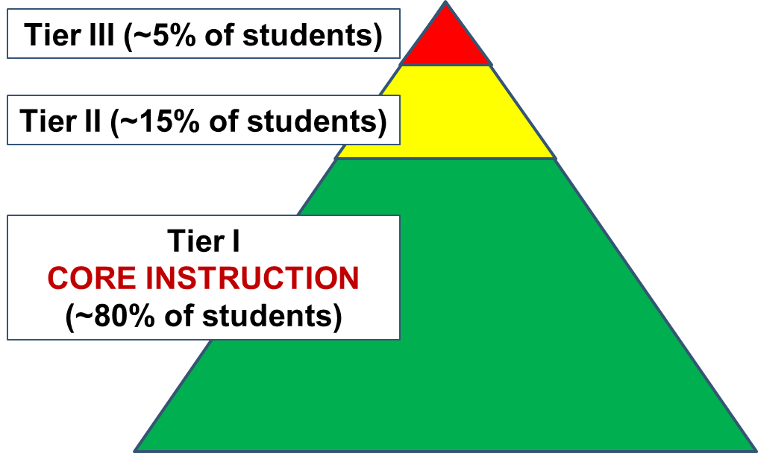
Who Receives Core Instruction?
Notes:
Requirements within ESSA and the Individuals with Disabilities Education Act (IDEA) are designed to strengthen access for all students to the general education curriculum. Access does not mean placement in a general education classroom, but rather is dependent on the quality of core instruction. Moreover, to be of high quality, core instruction needs to be aligned to standards and differentiated to meet the learning needs of all students.
The triangle here demonstrates how core instruction should successfully meet the needs of most students—meaning that approximately 80% of students should have both access and the ability to make progress toward the academic standards by virtue of core instruction provided in the general education classroom. Students who struggle to make progress toward the academic standards (e.g., students with disabilities, English language learners, at-risk students) should only represent approximately 20% of students, and those students should be provided additional services and supports with increased intensity to ensure equitable access to the curriculum.
Most associate this triangle with response to intervention (RtI) or multi-tiered systems of support (MTSS)—a framework that is designed to support all student learning with increased supports provided through Tier II and Tier III services. Poor core instruction can lead to poor student outcomes and create demands for additional supports for a broader student population. This creates extensive demands on both the general and special education teachers, causing additional stress and burnout, or, worse yet, triggering resentment or negative relationships among general and special education teachers.

Slide 18
All Means All!
All students need effective core instruction delivered in the general education setting.
This includes students with disabilities, learning differences, and language barriers.
Core curriculum should be research based and aligned with state or district standards.
Notes:
While efforts toward inclusion and a focus on equity reinforce the notion that all means all, it is often not enough to ensure that all students have access to the general education curriculum and are able to meet established proficiency levels. Teachers—both special and general—need the skills and competencies to provide quality core instruction. Given what we know about adult learning and what is needed to move from novice to expert, it is necessary to target specific instructional practices that can be learned, applied, and reinforced through practice and coaching.

Slide 19
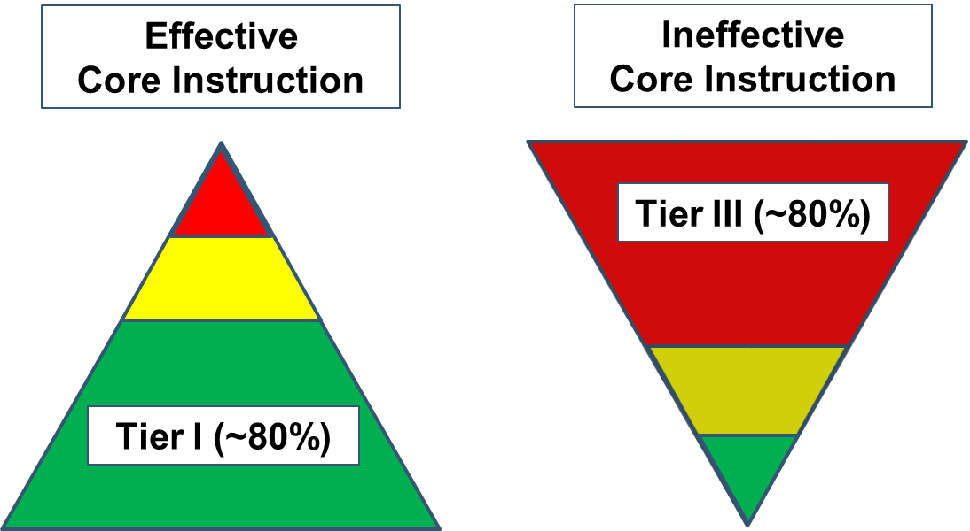
Equitable Access to Effective Instruction
Notes:
As mentioned earlier, ineffective core instruction will result in more students needing specialized and intensive supports, placing increasing demands on both general and special education teachers. In this situation, the MTSS triangle is inverted, meaning that more students need specialized support beyond core instruction—taxing the educator workforce and likely resulting in lower student achievement. A triangle that is inverted not only suggests that core instruction is poor, but also that shared ownership for all student learning is not present among all teachers and that an infrastructure or framework like MTSS is either not present or not functioning well within a school. A well-designed M&I program could help in addressing these issues, while also improving core instruction.

Slide 20
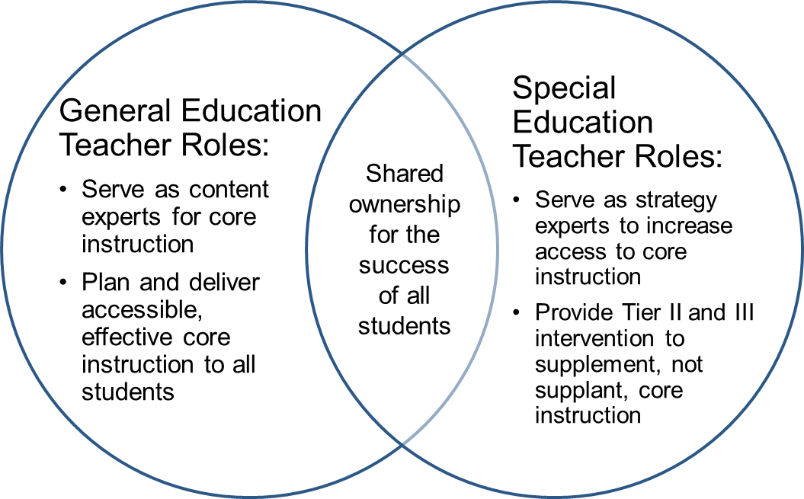
Effective Core Instruction Requires Shared Ownership
Notes:
Whether students are receiving services in the general education classroom, are provided Tier II or Tier III supports, or receive services in a separate classroom, quality core instruction requires collaboration and shared ownership among both general and special education teachers. In addition, the most effective core instruction likely leverages the experiences and expertise of general and special educators. General education teachers can lend their deep knowledge of the standards, content, and evidence-based instructional strategies, while special educators can lend expertise in ways to provide accommodations or differentiate instruction such that all students can learn. An M&I program can be designed to strengthen collaboration among teachers and to help establish roles and responsibilities. It should prevent using special education teachers as classroom aides in the back of the class, but rather utilize them as equal partners in planning instruction, learning activities, and assessments in core instruction that is responsive to diverse learning needs. Likewise, the program should recognize the role that general education teachers should play in informing resource room and separate classroom instruction, such that it is aligned to the content standards and leverages evidence-based instructional practices.

Slide 21
Team Discussion: Quality of Core Instruction
What is the quality of core instruction in your school/district?
How do teachers collaborate to ensure that all students are provided equitable access to core instruction?
Notes:
Facilitate a team discussion using the questions on the slide. Share out as a group.

Slide 22
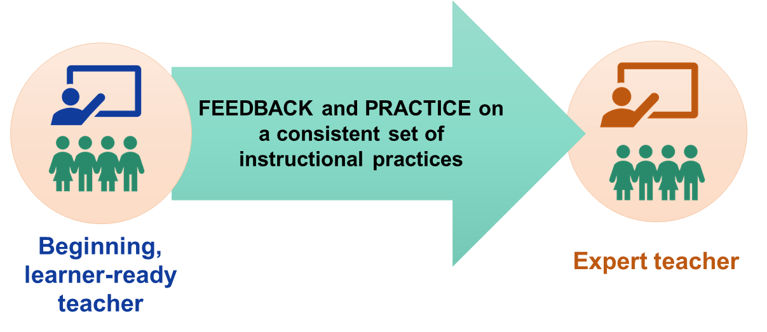
How Do We Support Beginning Teachers to Become Effective Core Instructors?
Notes:
Strengthening the core instruction provided by novice teachers (both general and special education) takes practice, practice, and more practice, paired with coaching and feedback. If learner-ready teachers are to become expert practitioners, then they need high-quality feedback, coaching, and practice on a consistent set of instructional practices. Mentorship that engages new teachers in goal setting, modeling, observation, and feedback has been shown to be effective at improving teachers’ instruction (Israel, Carnahan, Snyder, & Williamson 2013).

Slide 23
Mentoring & Induction is a Game-Changer
No preparation program can prepare a beginning teacher with all the skills necessary to be an expert on day 1.
A purposefully designed M&I program can bridge the preservice-to-inservice transition by reinforcing instructional practices that strengthen core instruction for all students.
High-quality core instruction means less likelihood of an “inverted triangle” that causes additional stress on school resources and teachers’ time.
Notes:
As noted earlier, no preparation program—no matter how good—is likely to prepare teacher candidates as expert practitioners. Mentoring and induction can help improve new teachers’ instruction by filling the gaps that exist between teacher preparation and the first years of teaching. A purposefully designed M&I program can help bridge the preservice-to-inservice transition by reinforcing instructional practices that strengthen core instruction. And, as a reminder, high-quality core instruction means that the triangle will be positioned correctly and not inverted, mitigating additional stress on school resources and teachers’ time.

Slide 24
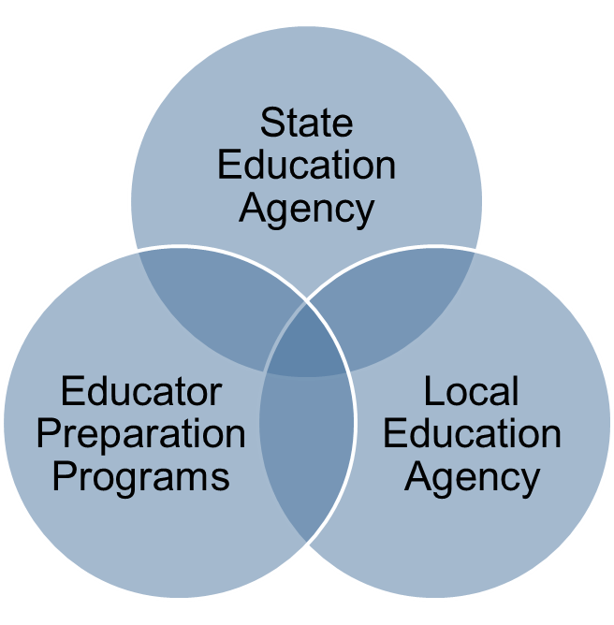
Collaborative Partnerships
Mentoring and Induction Partnerships:
Advance consistent expectations for core instructional practices from preservice to inservice.
Reinforce fidelity of implementation by providing multiple practice-based opportunities.
Notes:
Strengthening core instruction and establishing consistent expectations of instructional practices across preservice to inservice requires collaboration across SEAs, LEAs, and EPPs. These often loosely coupled organizations all have a shared interest in the quality of teachers; however, they operate under different policies, requirements, and priorities. Establishing strong partnerships can generate many important benefits. Most notably, doing so can advance consistent expectations of instructional practice for core or Tier I instruction that is shared across preservice to inservice. Additionally, each organization can play a role in reinforcing fidelity of implementation by providing multiple practice-based opportunities. For instance, EPPs can provide learning and field experiences, introducing candidates to instructional practices that can be further supported within LEAs through educator evaluation and professional learning systems. Likewise, SEAs can integrate common instructional practices within teacher standards and for EPP program approval standards. Strategies to strengthen collaborative partnerships are discussed in greater length in subsequent sections of this module, but it is important to note that strengthening core instruction takes collaboration across all partners and is an essential element to the success of this M&I model.

Slide 25
Goal 1:
Strengthen core instructional practices for all students, especially students with learning differences.
Notes:
In the previous section we discussed the need to strengthen core instruction for all learners. This section suggests a set of evidence-based instructional practices that can serve as the foundation to M&I programs designed to support teachers of all students—most particularly SWDs.

Slide 26

Improving Instructional Practice
Requires a laser-like focus on the critical features of effective performance!
Notes:
Improving instructional practice requires a laser-like focus on the critical features of effective performance. Research suggests that it takes years to develop expertise; experience alone is insufficient. Therefore, using multiple frameworks and promoting inconsistent instructional practices can confuse teachers and diminish the quality of the instructional practices used.

Slide 27
Turn and Talk
DISCUSS: What are the critical features of effective core instruction that enable all learners to access the general education curriculum?
  Think about SWDs, English language learners, and at-risk student populations.
REFLECT: Does your school or district currently have a consistent, defined set of practices for core instruction?
Notes:
Facilitate a team discussion using the questions on the slide. Share out as a group.

Slide 28
Frameworks That Promote Instructional Strategies
Danielson’s Framework for Teaching
Teaching and Learning Framework
Marzano’s 9 Instructional Practices for Effective Teaching and Learning
Teaching Works High-Leverage Practices
In-TASC Standards
Hattie’s 10 High-Impact Instructional Strategies
Notes:
This slide lists a number of commonly-used frameworks that define instructional practices. Depending on the SEA, LEA and even the EPP, one or more of these frameworks may be used to inform teacher’s instruction. At times these frameworks can complement one another; however, sometimes competing frameworks can send mixed messages regarding instructional practice.
Take a moment and list frameworks within your SEA, LEA, and EPP that inform what instructional practices teachers are taught and expected to use.

Slide 29
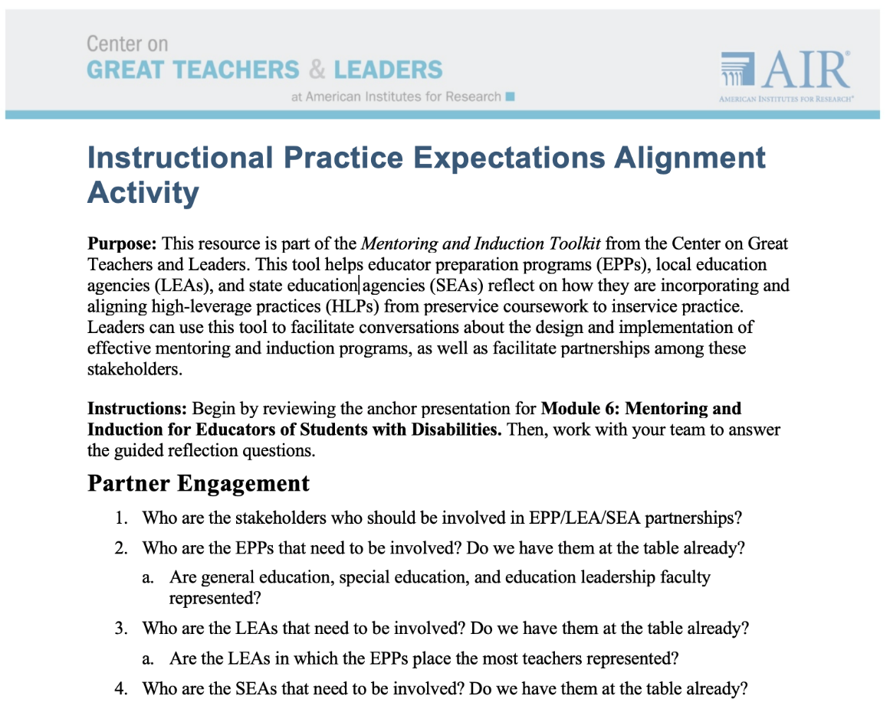
Toolkit Connection—Alignment Activity
Notes:
With a team consisting of SEA, LEA, and EPP representatives, complete the Instructional Practice Expectations Alignment Activity to assess the extent to which novice teachers experience consistent expectations of instructional practice throughout the preservice to inservice transition within your state, district, or region.
After completing the handout, facilitate a whole group discussion. Note places where expectations are aligned and where there are missed opportunities for alignment, including the consequences within both scenarios. Brainstorm next steps the team should consider to establish alignment.

Slide 30
What Are High-Leverage Practices (HLPs)?
“A set of practices that are fundamental to support K–12 student learning, and that can be taught, learned, and implemented by those entering the profession.”
(Windschitl, Thompson, Braaten, & Stroupe, 2012, p. 880)
Notes:
High-leverage practices (HLPs) are a set of practices—identified via research—fundamental to support K–12 student learning that can be taught to novice teachers and used to ensure equitable access to core instruction for all student learners.
A “high-leverage practice” is an action or task that is central to teaching. HLPs specify what ALL teachers should know and define HOW they deliver instruction. Carried out skillfully, these practices increase the likelihood that teaching will be effective for students’ learning.

Slide 31
How Are HLPs Used?
High-Leverage Practices (HLPs) are practices that can be woven into core instruction in the general education setting to intentionally design, deliver, and assess instruction that leads to equitable learning outcomes for all students, including students with diverse learning needs.
Notes:
High-leverage practices can be woven into core instruction. When used strategically and intensified per student needs, they can ensure that most students in the general education classroom can access the general education curriculum.

Slide 32
Features of HLPs
Focus directly on instructional practice
Occur with high frequency in teaching
Research based and known to foster student engagement and learning
Broadly applicable and usable in any content area or approach to teaching
Fundamental to effective teaching when skillfully executed
Source: Council for Exceptional Children and CEEDAR (2017)
Notes:
HLPs are appealing for both general education and special education audiences because these practices are applicable to and can be used in any content area or grade level. Some might consider HLPs to be common-sense practices that are used widely—which is true. That said, it is the intentionality with which HLPs are used to respond to specific learning tasks and student needs that makes them powerful. While HLPs can enhance all students’ learning with increased intensity and intentionality, SWDs, English language learners, and students who struggle are provided better access to the curriculum through HLPs.

Slide 33
HLP Frameworks
HLPs in Special Education
(examples)
  Explicit instruction
  Systematic instruction
  Flexible grouping
  Active student engagement
  Positive and constructive feedback
  Organized and respectful learning environments
Teaching Works HLPs
(examples)
  Explaining and modeling content and practices
  Coordinating and adjusting a lesson during instruction
  Specifying and reinforcing productive student behavior
  Building respectful relationships with students
Notes:
In partnership with the Collaboration for Effective Educator Development, Accountability and Reform (CEEDAR) Center, the Council for Exceptional Children (CEC) has developed a set of HLPs in special education. Although titled as designed for use in special education, these HLPs are practices that will support the learning of all students. Therefore, it is appropriate for these HLPs to be used by both general and special education teachers.
This slide demonstrates that the HLPs identified by CEEDAR and CEC align well with the Teaching Works High-Leverage Practices, another set of commonly-used HLPs, that are designed for all students. That said, the HLPs developed by CEEDAR are designed to strengthen core instruction for all learners and, if intensified, can support student learning at Tier II and Tier III.
The CEEDAR HLPs are organized around four aspects of practice: collaboration, assessment, social/emotional/behavioral, and instruction.
Within these four aspects of practice, there are 22 practices intended to address the most critical practices that K–12 teachers serving SWDs should know about and be able to demonstrate. The selected practices are used frequently in classrooms and have been shown to improve student outcomes if successfully implemented.
HLPs in Special Education: highleveragepractices.org
Teaching Works HLPs: http://www.teachingworks.org/work-of-teaching/high-leverage-practices

Slide 34
Engage and Interact
EXPLORE: Review Handout 1: High-Leverage Practices in Special Education.
VIEW: Video clip on HLP #16: Explicit Instruction.
DISCUSS: What did you notice in the video? How can HLPs be reinforced during the preservice-to-inservice transition for new teachers? How can HLPs be utilized in high-need schools to achieve equitable outcomes for all students?
Notes:
Handout 1 provides a brief overview of the 22 HLPs. With an elbow partner, take 5 minutes to review the HLPs. Once completed, watch the Explicit Instruction HLP video and answer the questions on the slide.
Lead group share-out.

Slide 35
So, HLPs Are Just Good Teaching?
Yes … and no.
  HLPs intentionally and systematically increase the intensity of core/Tier I instruction.
  HLPs must be intentionally selected and employed with student needs in mind.
  HLPs help bridge the gap between student needs and the learning task.
Notes:
Many may read the HLPs and suggest that these are just good teaching strategies. That is both correct and incorrect. Yes, HLPs are indeed good teaching practices, but it is the intentionality of their use that makes the distinction. Use and selection of HLPs should be based upon student learning needs and the specifics of the learning task.

Slide 36
A Few Caveats
HLPs do not replace the need to teach content using evidence-based practices.
HLPs do not imply that learning to teach is simply a matter of mastering these HLPs.
Notes:
It is important to note that HLPs do not replace the teaching of content using evidence-based practices (for example, teaching reading using an evidence-based phonics strategy). Additionally, HLPs do not replace the need for intensive intervention in certain circumstances. HLPs are not the end-all of education practices. Instead, they are strategies that will increase student access to content and curriculum. Often, HLPs are used to teach evidence-based instruction. For example, explicit instruction, an HLP, is often used while providing evidence-based reading instruction. When teaching nonreaders, teachers may also employ coaching and feedback (another HLP) to ensure that students master phonetic concepts.

Slide 37
Why Should We Focus on HLPs?
We can define effective practice for teachers, assess it, and then improve it!
We can create a seamless system of support for teachers throughout their career.
HLPs are content agnostic and can be used across all grades.
HLPs have been identified as practices all novice teachers should know and be able to do.
Notes:
Focusing on HLPs provides an opportunity to assess and improve specific practices. Understanding what we know about adult learning, teachers need practice with consistent feedback in order to implement instructional practices with fidelity, and we cannot expect teachers to master all instructional practices at one time. Targeting a consistent set of HLPs increases the likelihood of mastery among novice teachers.
Likewise, working together, SEAs, EPPs, and LEAs can establish the infrastructure to prepare and support HLP use from inservice to preservice. Partnerships to establish seamless transitions from preservice to inservice is discussed in subsequent sections of this module.

Slide 38
True or False?
1.) HLPs are just for special education teachers.
  FALSE. HLPs are for all teachers!
2.) When used effectively, HLPs can help promote equitable outcomes for SWDs and others with special learning needs.
  TRUE! HLPs can lead to improved student learning outcomes for all students in core instruction.
3.) HLPs are the same as evidence-based practices.
  FALSE. HLPs can be used in conjunction with evidence-based practices to teach important concepts and skills.
Notes:
Read the true/false statements aloud to the team and have them guess the answer. Pause after each answer to read the explanations below and discuss as a team.
1. HLPs are just for special education teachers.
FALSE. HLPs are not just for special education teachers! All students, including SWDs, are Tier I students first and foremost. It is the responsibility of ALL teachers—general and special education—to know how to use HLPs in their instruction.
2. When used effectively, HLPs can help promote equitable outcomes for SWDs.
TRUE! Ensuring equitable outcomes for SWDs means ensuring that each student receives high-quality core instruction with their general education peers.
HLPs can be used to intentionally design, deliver, and assess core instruction in the general education setting, leading to equitable learning outcomes for each student, especially SWDs.
3. HLPs are the same as evidence-based practices (EBPs).
EBPs are practices that (a) are supported by multiple high-quality studies utilizing research designs from which causality can be inferred and (b) demonstrate meaningful effects on student outcomes (Cook & Cook, 2011). These are identified by an evidence-based review process.
A few examples include the following:
- Teaching phonological awareness
- Activating background knowledge
- Teaching cognitive strategies to improve text comprehension
- Teaching students schemas for solving word problems
For more information about HLPs and EBPs please read this brief: http://ceedar.education.ufl.edu/wp-content/uploads/2017/11/HLPs-and-EBPs-A-Promising-Pair-FINAL.pdf

Slide 39
High-Leverage Practices: The Foundation of Mentoring & Induction
Notes:
We have spent considerable time learning about HLPs and their benefit for all students’ learning. Likewise, we have discussed that these practices are designed such that teacher candidates and learner-ready teachers can master them in their first years of teaching with coaching and support. Using the HLPs as the foundation of a mentoring and induction program offers an opportunity to provide consistency in expectations and coaching and feedback to reinforce mastery.

Slide 40
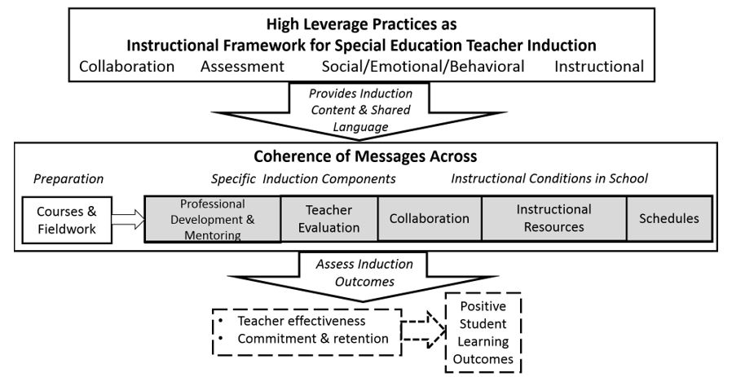
A Common Language for Core Instruction
Source: Billingsley, Bettini, & Jones (in press).
Notes:
This figure shows how HLPs might be used to create a common language for core instruction within an instructional framework for induction. It specifies how leaders and policymakers can support the use of these practices, while helping new teachers make sense of their roles. When HLPs are used to provide content for induction and shared language for discussing instruction, then this sends coherent messages across the preservice to inservice career continuum about new teachers’ roles and instructional responsibilities.
In order to reinforce HLPs, we must make sure there is coherence of messages across the career continuum – from teacher preparation, to specific induction components for new teachers, to the instructional conditions in school. Aligned professional learning and support structures that promote the use of core instructional practices have the potential to result in improved instructional practices, higher retention, and stronger student outcomes (Billingsley, Bettini, & Jones, in press).
In the next few slides, we will break down the components of this coherence of messages from preservice to inservice.

Slide 41
Toolkit Connection—HLPs
Does your team need help assessing the extent to which your district induction program incorporates HLPs? Try this toolkit resource!
Induction for Beginning Teachers of Students with Disabilities Needs Assessment—High-Leverage Practices Supplement
Notes:
Toolkit materials can be accessed on the GTL Center website: https://gtlcenter.org/.

Slide 42
Goal 2:
Increase coaching and feedback opportunities through M&I.
Notes:
Targeting a consistent set of instructional practices is the first step to mastery. Next, the practices need to be taught and opportunities to apply them need to be provided. Developing a level of expertise does not come from reading or learning about a strategy or even engaging in observation. It is developed through careful practice coupled with constructive coaching and feedback.

Slide 43
Practice-Based Opportunities
What are practice-based opportunities?
  Opportunities to integrate both content and pedagogy acquired through coursework or professional learning into instruction (Ericsson, 2014).
Why are practice-based opportunities important?
  Teacher candidates are more likely to be effective and to stay in the profession when their preparation experiences are connected to classroom practice (Boyd, Lankford, Loeb, & Wyckoff, 2009; Ronfeldt & Reininger, 2012).
Notes:
Practice combined with feedback focused on the main components of effective performance (HLPs) is essential to development of expertise over time. Teachers often learn about instructional practices, with little opportunity to practice in real classrooms with real students. Practice-based coaching and feedback opportunities provide teacher candidates and novice teachers with opportunities to integrate both content and pedagogy learned in coursework/professional learning into instruction. Simply put, this means that the skills—for example, evidence-based instructional practice—are then practiced.
M&I can provide the needed infrastructure to provide novice teachers with opportunities for coaching and feedback.

Slide 44
Three Key Ideas
Focus is the degree to which opportunities to practice are targeted on specific skills.
Duration is the length of time that candidates or novice teachers are offered to extend learning and develop mastery.
Coherence is the extent to which common practices are reinforced and advanced across the career continuum.
Notes:
There are three key ingredients to high-quality practice-based opportunities: first, focus—the degree to which opportunities to practice are targeted on specific skills (in this case, the opportunity to practice HLPs); second, duration—the length of time candidates or novice teachers are offered to extend their learning and develop mastery; and, last, coherence—the extent to which common practices are reinforced and developed across the career continuum.
Research suggests that professional development and M&I are more likely to be effective when the experiences are focused, occur over time, and are coherent (Benedict, Holdheide, Brownell, & Foley, 2016; Hindman, Wasik, & Snell, 2016; Phillips, Desimone, & Smith, 2011).

Slide 45
Features Within M&I Programs
M&I programs can be designed to:
  Include frequent opportunities for modeling and observation
  Bridge preservice to inservice expectations with experiences that are spaced, varied, and scaffolded
  Provide a consistent model of coaching and feedback
  Feature opportunities for analysis and reflection
Notes:
Research on the science of learning and high-quality professional development suggests that practice-based opportunities that include the following features will lead to improved teacher practice: modeling, spaced learning, varied learning with diverse students and different contexts, scaffolding, coaching, feedback, and opportunities for analysis and reflection. M&I programs can be designed to provide support in the use of HLPs over time that include these features.

Slide 46
Goal 3:
Strengthen partnerships and specify roles.
Notes:
The next section of the module speaks to the need for strong partnerships to support M&I.

Slide 47
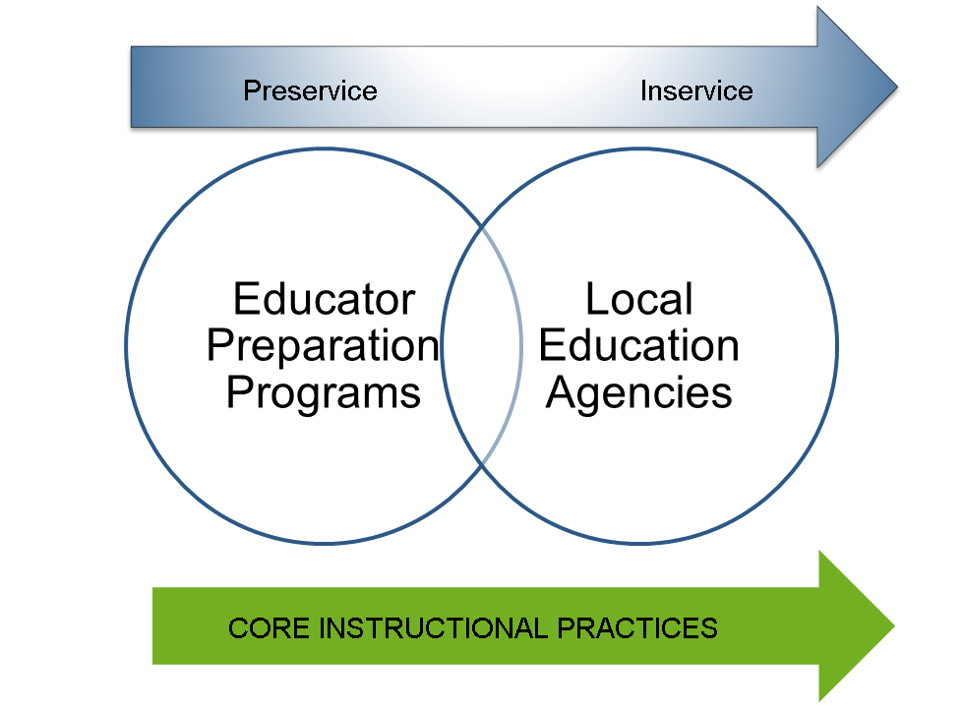
Partnerships Are Key
Notes:
Provided consistent expectations of instructional practice from preservice to inservice, and multiple practice-based opportunities paired with coaching and feedback, novice teachers are more likely to improve their practice (Benedict et al., 2016; Billingsley, Bettini, & Jones, in press). To do that, SEAs, LEAs, and EPPs need to partner, as each plays a role in the preparation and success of teachers. That said, each partner has a distinct role in teacher support across the educator career continuum. While each partner has its own requirements and priorities, working in isolation has the potential to send mixed messages about expectations. This graphic demonstrates that even though each partner operates under different priorities and requirements, establishing consistent expectations of instructional practice can lead to better teacher practice and improved student outcomes.

Slide 48
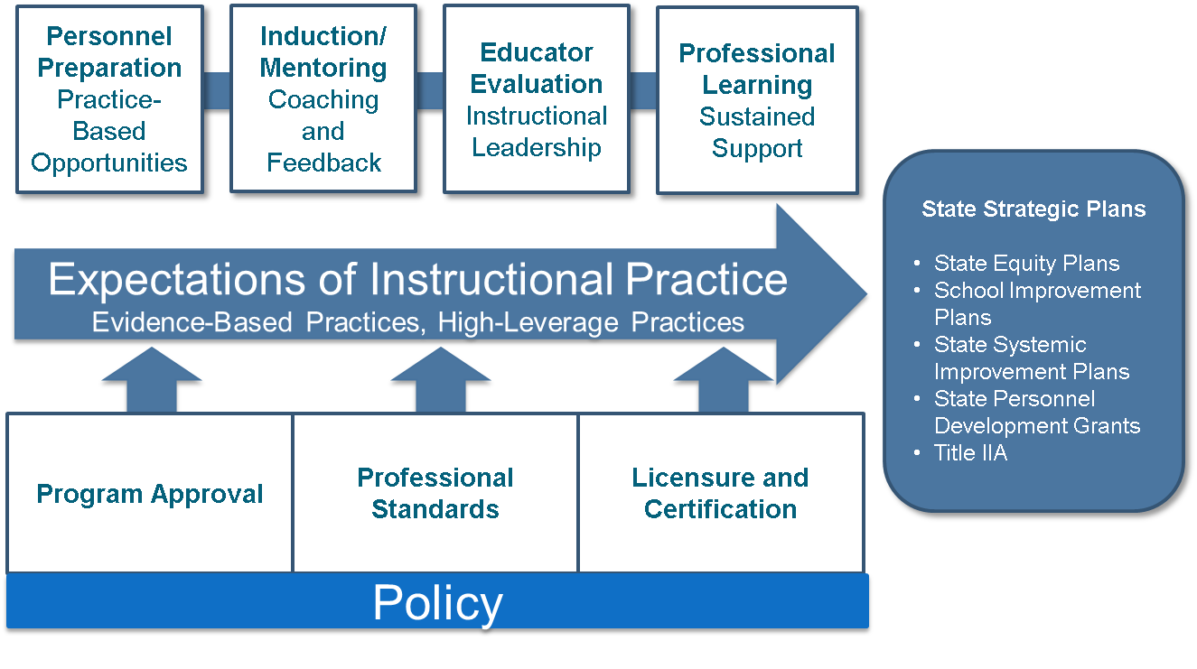
Consistency in Instructional Expectations
Notes:
As demonstrated in this graphic, each partner plays a specific role in reinforcing common expectations of instructional practice. SEAs have a role in creating the policy conditions that support expectations of instructional practice, including program approval, professional standards, and licensure/certification. These expectations should be reinforced by EPP and LEA partners throughout the career continuum, from preparation, to mentoring and induction, to educator evaluation, to professional learning systems. These expectations of instructional practice can be further reinforced through state strategic plans, such as state equity plans, school improvement plans, State Systemic Improvement Plans, State Personnel Development Grants, and Title IIA plans.

Slide 49
Coalescing on Shared Goals
Form a team of representatives from the SEA, LEA, and EPP or utilize an existing team
Establish a shared vision of M&I for novice teachers
Utilize the GTL Center M&I toolkit to make design decisions for M&I programs
Designate roles for each partner or identify how existing efforts can be leveraged to support the M&I program
Create an action plan
Notes:
Forming a team of representatives from the SEA, LEAs, and EPPs can stimulate discussions about novice teacher needs that can then help design a mentoring and induction program. While the steps listed on this slide may sound simplistic, collaborating such that partners are working together towards a common goal takes time, patience, and tenacity. That said, once formed, passions emerge and innovative ideas are generated. Often, federal or state technical assistance centers like the GTL Center can help facilitate discussions among partners.

Slide 50
State Education Agencies
Potential Roles
Notes:
The next sections speak to potential roles across partners. This section focuses on the potential roles of state education agency partners.

Slide 51
Supporting M&I Through State Policy
Require M&I for new teachers that advances partnerships between LEAs and EPPs.
Provide support to implement M&I programs that focus on HLPs within the comprehensive and targeted systems of support for low-performing schools required by ESSA.
Create teacher and leader standards that integrate skills concerning the HLPs, instructional coaching, and collaboration among special and general educators.
Establish program approval and school improvement policies that stimulate partnerships and encourage shared ownership and accountability for M&I programs.
Notes:
While in large part local districts are charged with implementing mentoring and induction programs, SEAs can provide the infrastructure to advance their use and implementation. For example, policy could be established that not only requires M&I programs but also advances partnerships between LEAs and EPPs.
SEAs are also charged with providing comprehensive and targeted systems of support to low-performing schools, with an emphasis on the use of evidence-based practices. Quality M&I programs have been proven to improve teacher practice and retention. Likewise, the HLPs have a solid evidence base. Given that it is likely that core instruction is poor in low-performing schools and/or that student subgroups are unable to progress within a general education classroom, SEAs reinforcing the use of M&I programs within their comprehensive and targeted systems of support may result in improved core instruction and student performance.
Ensuring that teacher and leader standards include references to the HLPs, support skills in instructional coaching, and facilitate increased collaboration among special and general educators can help advance quality implementation of M&I programs.
Although SEAs are not in a position to implement M&I programs in isolation, they play a critical role in establishing the needed infrastructure to carry out M&I programs.

Slide 52
Secure Funding
Title II, Part A funds can be used to support initiatives to assist in recruiting, hiring, and retaining effective teachers.
ESSA preserves the Rural Education Achievement Program (REAP), which provides resources to rural school districts to develop and retain teachers.
Individuals with Disabilities Education Act (IDEA) funds can be used to provide professional learning and support to all teachers (both general and special educators) as long as it is of benefit to SWDs.
Notes:
Both ESSA and IDEA funds can be leveraged to support M&I program development and implementation. Title IIA funds, Rural Education Achievement Program (REAP) funds, and IDEA funds can be used to support efforts to retain teachers. For example, REAP funds can be used provide substitutes to cover classrooms while teachers observe other classrooms and/or stipends for mentors.
It is important to note that both ESSA and IDEA outline requirements for professional learning. These requirements align with the essential features of practice-based opportunities addressed earlier in this module.
Learn more about REAP, check your district’s eligibility, and apply for funds at www2.ed.gov/nclb/freedom/local/reap.html.

Slide 53
Local Education Agencies and Schools
Potential Roles
Notes:
This section focuses on the potential roles of local education agency and school partners.

Slide 54
Supports for Mentors and Instructional Coaches
Recruit and select teacher-leaders with demonstrated skill teaching diverse learners.
Require ongoing professional development for teacher-leaders with an emphasis on HLPs and the essential features of practice-based opportunities.
Train teacher-leaders to provide instructional coaching and feedback to beginning teachers on HLPs.
Notes:
The design of mentor selection and support is addressed within the broader GTL M&I toolkit. When considering support for mentors and instructional coaches for novice teachers supporting students with disabilities, there are some special features to consider.
First, selecting mentors who have a track record of instructional success with diverse learners is important. These mentors could—and probably should—include both special and general educators. It is important to demonstrate shared ownership and expertise to novice and veteran teachers.
It is also important that the mentors get professional learning and support that addresses HLPs, including what the practices are, how they look in classrooms, and ways to provide high-quality instructional coaching.
Mentors should also understand the essential features of practice-based opportunities and be provided the infrastructure to provide high-quality learning experiences for their mentees.
Tools and Resources:
GTL Mentoring & Induction Toolkit
Module 2: Mentor Recruitment, Selection, and Assignment
Module 3: Mentor Professional Learning, Development, and Assessment
New Teacher Center Mentor Practice Standards

Slide 55
Principal Roles and Responsibilities
Establish an inclusive environment by promoting co-mentoring by general and special educators.
Create an infrastructure that supports time for collaboration, time for mentors to observe novice teachers in classrooms, time for mentors to provide feedback, and time for novice teachers to reflect upon their practice.
Ensure that mentors have protected time to perform their duties and are provided professional learning and support.
Notes:
Inclusive principals establish high expectations and provide appropriate supports for SWDs. They play an essential role in improving instruction, promoting collaboration between general and special education teachers, and retaining effective teachers of SWDs.
The success of an M&I program is largely dependent on the principal establishing an infrastructure that supports quality implementation. The principal sets the culture in a school and plays a critical role in establishing an inclusive environment. Selecting general and special education teachers as mentors and promoting co-mentoring for novice teachers can send a strong message to the staff. While mentors are often matched with role-alike teachers, general and special education teachers modeling collaboration can set those expectations for novice teachers.

Slide 56

Professional Development Guide for School Leaders
Getting to Know HLPs
Sharing HLPs
Reflecting on HLPs
Additional Resources:
HLP Website
HLP Videos
https://highleveragepractices.org/
Notes:
Introducing High-Leverage Practices in Special Education: A Professional Development Guide for School Leaders is a resource to help principals, special education administrators, mentors, coaches, and other school-based leaders implement K-12 professional development on HLPs. The resource is a free, web-based guide with interactive tools and fillable forms
that can be downloaded online at highleveragepractices.org.

Slide 57
Alignment Example: Teacher Evaluation
Reinforce HLPs through educator effectiveness feedback.
Connect educator effectiveness feedback with professional learning opportunities that strengthen use of HLPs.
Tools and Resources:
Inclusive Design: Building Evaluation Systems That Support SWDs
A Framework for Coherence: College and Career Readiness Standards, Multi-Tiered Systems of Support, and Educator Effectiveness
Notes:
Teacher evaluation is another aspect of aligning preservice to inservice expectations around HLPs. Feedback provided in accordance with educator effectiveness and evaluation systems should reinforce HLPs in the same manner that coaching and feedback opportunities provided through M&I supports should reinforce HLPs. Using HLPs to provide a common language for core instruction helps to create consistency in instructional expectations between teacher evaluation and M&I.

Slide 58
Alignment Example: Instructional Conditions
Promote collaboration between general and special education teachers.
Build a school culture around instructional improvement.
Provide teachers with dedicated time to plan for HLP-driven core instruction.
Tools and Resources:
Understanding Teaching Conditions Professional Learning Module
  Explores issue of working conditions and why the quality of conditions matters.
Notes:
To retain teachers of SWDs, we need to create school environments where special educators and their students can thrive. To do that, LEAs must ensure that local M&I programs have infrastructure that allows time, space, and resources for collaboration.
One important action is to promote general education and special education collaboration. All educators should have the skills to support inclusive practices for students with disabilities. A collaborative school culture allows general and special educators and leaders to collaborate and problem solve around student needs. School collaboration can be developed and promoted through professional development opportunities at both the school and district level.
Another important action is to create a culture of asking for help and talking about instruction. School leaders should foster a safe environment where teachers feel comfortable asking for help and support from other teachers and leaders. Additionally, school leaders should be knowledgeable about instructional practices and thus be able to have discussions and provide support in this area to teachers of SWDs. Too often, school leaders’ preparation centers on the special education’s legal aspects. But for principals to be instructional leaders, they must know which type of instruction works best for SWDs.
Understanding Teacher Working Conditions—a resource from the Center on Great Teachers and Leaders—explores what working conditions are and why the quality of working conditions matters. It describes how working conditions data can be used at the district and school levels to create a more positive teaching and learning environment that ultimately promotes educator effectiveness and professional growth.

Slide 59
New Teacher Center Resources
2018 Teacher Induction Program Standards
  Provide school leaders with a framework for supporting new teachers during their first 2–3 years in the classroom.
Supporting Effective Educator Development (SEED) Grant Model
  Grants help high-needs districts hire, develop, and retain highly effective teachers.
  Support starts during a teacher’s preservice experience and continues throughout their first 2 years of teaching.
Notes:
The New Teacher Center (NTC) provides several resources that can support strong district partnerships.
The development of instructionally focused mentoring and induction is consistent with NTC’s Teacher Induction Program Standards. These standards provide school leaders with a framework for supporting new teachers during their first 2 to 3 years in the classroom. The standards state that “well-qualified, carefully selected, extensively trained” mentors are just as necessary for a new teacher’s success as an effective teacher is for the success of students. Written as a series of statements and questions, the standards emphasize the role of school leaders and asks, for example, “How can school leaders foster high-quality, instructionally focused mentoring at their sites?” and “What structures and protocols can we provide to ensure appropriate opportunities for strategic three-way conversations between the school leader, the beginning teachers, and the mentor?”
NTC has recently received a SEED grant that it will use to explore the connection between preservice and inservice teaching and training cooperating teachers and education professors in the NTC model. The SEED grant program provides funding to increase the number of highly effective educators by supporting the implementation of evidence-based preparation, development, or enhancement opportunities for educators. NTC will use these funds to help high-needs districts hire, develop, and retain highly effective teachers. These supports will start during a teacher’s preservice experience and will continue throughout their first 2 years of teaching. NTC will focus its efforts in Chicago Public Schools and Miami-Dade County Public Schools to increase teacher retention and student achievement.

Slide 60
Educator Preparation Programs
Potential Roles
Notes:
This section focuses on the potential roles of educator preparation program partners.

Slide 61
Alignment Example: Preparation
Integrate HLPs into preservice coursework.
Strengthen field experiences for all teachers to include practice-based experiences with SWDs and other students with learning differences.
Train cooperating teachers to observe and provide feedback on HLPs.
Tools and Resources:
Learning to Teach: Practice-Based Preparation in Teacher Education
Notes:
The teaching, learning, and practice of HLPs should be integrated throughout coursework in preservice preparation programs. Coursework should include multiple practice-based components, particularly in methodology courses and courses that address pedagogy.
Additionally, most states do not require general education teacher candidates to have field experiences with SWDs. EPPs should consider how they will provide all teacher candidates with these valuable opportunities.
The featured tool on this slide is a brief from CEEDAR and the GTL Center that outlines essential features for providing high-quality, structured, and sequenced opportunities to practice within teacher preparation programs. It highlights the following practice-based approaches, which have been found to increase beginning teacher candidates’ capacity for teaching: spaced learning opportunities, varied learning opportunities, microteaching, case-based instruction, virtual simulations and lab-like experiences, and video analysis.

Slide 62
Features of Educator Preparation Program-District Partnerships
School-based, practice-based preparation experiences for preservice teachers
  May occur through professional development schools or alternative certification routes
Faculty directly involved in the design and delivery of beginning teacher inservice supports
  Onsite mentoring for inservice teachers/program graduates
  Beginning teacher development curriculum
  Training for cooperating teachers, mentors, and instructional coaches
Notes:
Partnerships among EPPs and school districts are desirable. Partnerships enable organizations to leverage their resources as well as expand and enhance their capabilities. They also provide opportunities for personnel with specialized areas of expertise to address shared challenges. One strategy to share expertise across partners is to have EPP faculty bridge the preservice to inservice transition by providing school-based, practice-based preparation experiences for preservice teachers while also being directly involved in the design and deliver of beginning teacher inservice supports such as mentoring and beginning teacher professional development.

Slide 63
Example Educator Preparation Program–District M&I Partnerships
Louisiana Mentor Teachers
  All teacher preparation programs include a year-long classroom residency alongside an experienced mentor teacher.
University of Wyoming College of Education and Albany County School District #1
  Sends preservice teachers into existing K–12 classrooms and brings K–12 teachers and students into College of Education classrooms.
Tennessee Educator Preparation Policy 5.504
  EPPs are required to have at least one primary partnership with a Tennessee LEA.
Notes:
This slide shows some examples of M&I partnerships between EPPs and LEAs.
Louisiana Mentor Teachers: As of July 2018, all teacher preparation programs in Louisiana include a yearlong classroom residency alongside an experienced mentor teacher, and all preparation programs include a competency-based curriculum that will provide teacher candidates with the knowledge and skills needed to be prepared for their first day of teaching. To ensure that there is a robust pool of effective mentors, Louisiana will establish a cohort of at least 2,500 trained mentors over the next 3 years. These mentors will be equipped to support yearlong residents and other new or developing teachers.
Through their work with the Teach to Lead summit, Wyoming created a structure for preservice teachers to work with mentor teachers in existing schools on specific skill development such as lesson planning, classroom management, and instructional strategies. The team additionally put together a series of mentoring workshops for mentor teachers and College of Education instructors to discuss mentoring and coteaching models.
As outlined in the Tennessee Educator Preparation Policy 5.504, all Tennessee EPPs are required to have at least one primary partnership with a Tennessee LEA. In addition, EPPs must have evidence regarding additional partnership activities.

Slide 64
Example: Georgia
The Georgia Department of Education, the University System of Georgia, the Georgia Professional Standards Commission, and the CEEDAR Center have partnered to provide a year-long professional development series for all universities statewide on using HLPs in coursework and fieldwork.
Tools and Resources:
Georgia HLP/MTSS Summit
Georgia HLP Webinar Series
Notes:
This slide features an example from Georgia that demonstrates how SEA, LEA, and EPP partners are working together to create consistent expectations for HLPs across the career continuum. Review the resources and discuss as a team.

Slide 65
Further HLP Resources
HLPs in Special Education (full report)
HLPs for Inclusive Classrooms (book)
HLPs and Teacher Preparation in Special Education (research brief)
Notes:
This slide features further resources related to HLPs.

Slide 66
References

Slide 67
References (continued)
Benedict, A., Holdheide, L., Brownell, M., & Foley, A. M. (2016). Learning to teach: Practice-based preparation in teacher education. Washington, DC: Center on Great Teachers and Leaders. Retrieved from https://files.eric.ed.gov/fulltext/ED570144.pdf
Billingsley, B., Bettini, E., & Jones, N. (In press). Supporting special education teacher induction through high leverage practices. Remedial and Special Education.
Boyd, D., Grossman, P., Lankford, H., Loeb, S., Wyckoff, J., & Urban, I. (2009). Teacher preparation and student achievement. Education Evaluation and Policy Analysis, 31(4), 416–440. doi:10.3102/0162373709353129
Cameron, D. L., & Cook, B. G. (2007). Attitudes of preservice teachers enrolled in an infusion preparation program regarding planning and accommodations for included students with mental retardation. Education and Training in Developmental Disabilities, 42(3), 353.
Cook, B. G., & Cook, S. C. (2011). Thinking and communicating clearly about evidence-based practices in special education. Arlington, VA: Council for Exceptional Children.
Council for Exceptional Children and CEEDAR. (2017). High-leverage practices in special education (HLPs). Arlington, VA: Council for Exceptional Children & CEEDAR Center. Retrieved from http://ceedar.education.ufl.edu/wp-content/uploads/2017/11/HLP-flyer-list.pdf

Slide 68
References (continued)
Ericsson, K. A. (2014). The road to excellence: The acquisition of expert performance in the arts and sciences, sports, and games. Florence, KY: Psychology Press.
Goldrick, L., Sindelar, P., Zabala, D., & Hirsch, E. (2014). The role of state policy in preparing educators to meet the learning needs of students with disabilities (Document No. PA-1). Retrieved from http://ceedar.education.ufl.edu/wp-content/uploads/2014/10/PA-1_FINAL_10-21-14.pdf
Harr-Robins, J., Song, M., Hurlburt, S., Pruce, C., Danielson, L., Garet, M., & Taylor, J. (2012). The inclusion of students with disabilities in school accountability systems (NCEE 2012-4056). Washington, DC: National Center for Education Evaluation and Regional Assistance, Institute of Education Sciences, U.S. Department of Education.
Hindman, A. H., Wasik, B. A., & Snell, E. K. (2016). Closing the 30 million word gap: Next steps in designing research to inform practice. Child Development Perspectives, 10(2), 134–139.
Holdheide, L., & Demonte, J. (2016). Critical shortages in special education teachers: Sound familiar? Washington, DC: American Institutes for Research. Retrieved from https://www.air.org/resource/critical-shortages-special-education-teachers-sound-familiar

Slide 69
References (continued)
Israel, M., Carnahan, C. R., Snyder, K. K., & Williamson, P. (2013). Supporting new teachers of students with significant disabilities through virtual coaching: A proposed model. Remedial and Special Education, 34(4), 195-204.
Leko, M. M., Brownell, M. T., Sindelar, P. T., & Kiely, M. T. (2015). Envisioning the future of special education personnel preparation in a standards-based era. Exceptional Children, 82(1), 25-43.
Papay, J., Bacher-Hicks, A., Page, L., & Marinell, W. (2018, January 9). America’s teacher shortage can’t be solved by hiring more unqualified teachers. Washington Post. Retrieved from https://www.washingtonpost.com/news/posteverything/wp/2018/01/09/americas-teacher-shortage-cant-be-solved-by-hiring-more-unqualified-teachers/?noredirect=on&utm_term=.5e5ce9364afa
Phillips, K. J., Desimone, L., & Smith, T. M. (2011). Teacher participation in content-focused professional development and the role of state policy. Teachers College Record, 113(11), 2586-2621.
Ronfeldt, M., & Reininger, M. (2012). More or better student teaching? Teaching and Teacher Education, 28(8), 1091-1106.
Smith, T. M., & Ingersoll, R. M. (2004). What are the effects of induction and mentoring on beginning teacher turnover? American Educational Research Journal, 41(3), 681-714.

Slide 70
References (continued)
Sutcher, L., Darling-Hammond, L., & Carver-Thomas, D. (2016). A coming crisis in teaching? Teacher supply, demand, and shortages in the U.S.. Palo Alto, CA: Learning Policy Institute. Retrieved from https://learningpolicyinstitute.org/sites/default/files/product-files/A_Coming_Crisis_in_Teaching_REPORT.pdf
Vaughn, S., & Wanzek, J. 2014. Intensive interventions in reading for students with reading disabilities: Meaningful impacts. Learning Disabilities Research and Practice, 29(2).
Windschitl, M., Thompson, J., Braaten, M., & Stroupe, D. (2012). Proposing a core set of instructional practices and tools for teachers of science. Science Education, 96(5), 878-903. doi:10.1002/sce.21027

Slide 71
Disclaimer
This content was produced under U.S. Department of Education, Office of Special Education Programs, Award No. S283B120021. David Guardino serves as the project officer. The views expressed herein do not necessarily represent the positions or polices of the U.S. Department of Education. No official endorsement by the U.S. Department of Education of any product, commodity, service, or enterprise mentioned in this website is intended or should be inferred.

Slide 72
More questions?
Contact the GTL Center!
1000 Thomas Jefferson Street NW
Washington, DC 20007-3835
877-322-8700
gtlcenter@air.org
www.gtlcenter.org | www.air.org

